Slide 1
Analytics with NRT Intelligence on Azure
Azure Discovery Days 2019
Patrick El-Azem
Cloud Solution Architect, Microsoft
Patrick.El-Azem@microsoft.com
LinkedIn: pelazem

Slide 2
Agenda
08:00 AM: Check In, Welcome
09:00 AM: Presentation, Lab Review
11:00 AM: Break
11:15 AM: Hands-On Labs!
12:00 PM: Lunch
04:15 PM: Wrap-up, Q&A

Slide 3
About Today
You:
Are Technical; data, dev, architect, …
Do NOT need to be an Azure expert
Are looking for a broad overview and guided hands-on work with help from proctors (if needed)
Pre-Requisites: None
We will provide you with Azure resources (or use your own)
There is nothing to install on your laptop if you use the provided Azure resources
~25% Presentation / ~75% Hands-On Labs
Lab docs = very detailed guidance
Our goal is for you to finish all the labs!

Slide 4
All materials for today (docs, labs):
https://aka.ms/danrt
Provision Azure environment for labs:
https://aka.ms/danrt-0130
→ Please note: lab environments will be deleted after 10 hours.
If you have an existing Azure subscription and want to keep what you build today, you do not need to work in the lab environment. If you work in your own Azure environment, please ensure you are complying with your organization’s applicable policies and constraints.
Notes:
All resources for today’s event are at the first link, which points to a public github repository which we will keep updated as this event evolves. For example, when new Azure capabilities are released, we may change the technologies or procedures used in this event.
The second link is valid only for today. Please use it to provision an Azure environment that you can use for all the hands-on labs today. These environments will be deleted after ten (10) hours, so please ensure that you preserve anything you do there that you do not want to lose. Remember that you can access the lab docs for this event anytime at the top link.

Slide 5


Your vision. Your cloud.
Notes:
Let’s do a quick technical overview of the Microsoft Azure cloud platform. This won’t be an exhaustive review; please see the Resources at the end of this deck for much, much more.

Slide 6
Why cloud?
Traditional datacenter
Expensive, vertically integrated hardware
Complex and time-consuming scalability
Overloaded IT teams with isolated security and management
Siloed infrastructure and DevOps teams
Cloud
Industry-standard hardware
Elasticity to scale up and down instantly
No need to worry about underlying cloud infrastructure and its security
Service-focused DevOps
Cloud adoption on the rise
62%
use cloud as a platform for modernizing IT environments
87%
plan to integrate their on-premises datacenter with public cloud
$266B
public cloud market by 2021
Notes:
Why do organizations consider cloud? Why would an organization like our scenario’s taxi companies go hybrid cloud, or even cloud first?
Traditional datacenters serve us well. But there is a significant hardware cost, both to provision and to maintain and scale it. IT teams have to handle everything from power and cooling all the way up to deploying software and patches. When many teams in an organization depend on datacenter infrastructure, operations and communication complexity go up.
Public cloud is built on industry-standard hardware, and generally customers do not need to worry about the details of the underlying hardware. Cloud provides elasticity to scale up and down rapidly, and allows organizations to adopt a service- and capability-centric technology operations model, and to adjust the balance between cap ex and op ex flexibly and quickly.
Cloud adoption is on the rise. The public cloud market is growing rapidly as organizations realize the benefits of adding, or moving to, cloud.

Slide 7


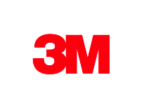
























>95% of Fortune 500 use Microsoft Azure
Notes:
Over 95% of the Fortune 500 are already using Microsoft’s public cloud platform, Azure.

Slide 8
Azure. Cloud for all.
Productive
Hybrid
Intelligent
Trusted
Notes:
Azure. Cloud for all.
These 4 pillars represent the value proposition for Azure.
Productive
Get unparalleled productivity with integrated tools across data, dev/ops, serverless computing, machine learning and artificial intelligence, and more.
Hybrid
Develop and deploy where you want, with the only consistent hybrid cloud on the market. Extend Azure on-premises with Azure Stack.
Intelligent
Create intelligent apps that delight with data-driven experiences. Go quickly from concept to release with Azure data services and artificial intelligence, from image recognition to bot services.
Trusted
Startups, governments, and >95 percent of Fortune 500s trust the Microsoft Cloud for security, privacy, transparency, and the most compliance coverage of any cloud provider. The Azure Trust Center provides a one-stop resource for compliance, certification, and security needs.

Slide 9
Unparalleled productivity
Productive
Integrated tooling
Visual Studios Third parties | DevOps
100+ services
Azure Functions Kubernetes | Logic Apps
Unified management
Single cloud | Policy
Hybrid
Intelligent
PLAN
DEPLOY
INTEGRATION
CONTINUOUS DEVELOPMENT
Trusted
CONTINUOUS
BUILD
OPERATE
Notes:
Azure offers unparalleled productivity.
Build using your platform and language of choice, including .NET, Java, Node.js, Python, and more.
Use best in class tools that you already know, including Visual Studio and Visual Studio Code.
Choose from over 100 services to architect and deploy platforms and applications. Azure provides services such as Kubernetes and other top open source technologies, to bots to serverless to big data to machine learning and AI to apps and much more. Additionally, Azure provides over 150 integration connectors for platforms like Salesforce, Dynamics, Office 365, Google services, and more.
Azure provides end to end management and monitoring. Use the Azure portal, the Azure Command Line Interface, bash, Powershell, or the REST APIs to deploy and manage resources. Use Azure Monitor for diagnostics, metrics, log analytics, and alerting across resources, and integrate it with existing security and operations management systems.

Slide 10
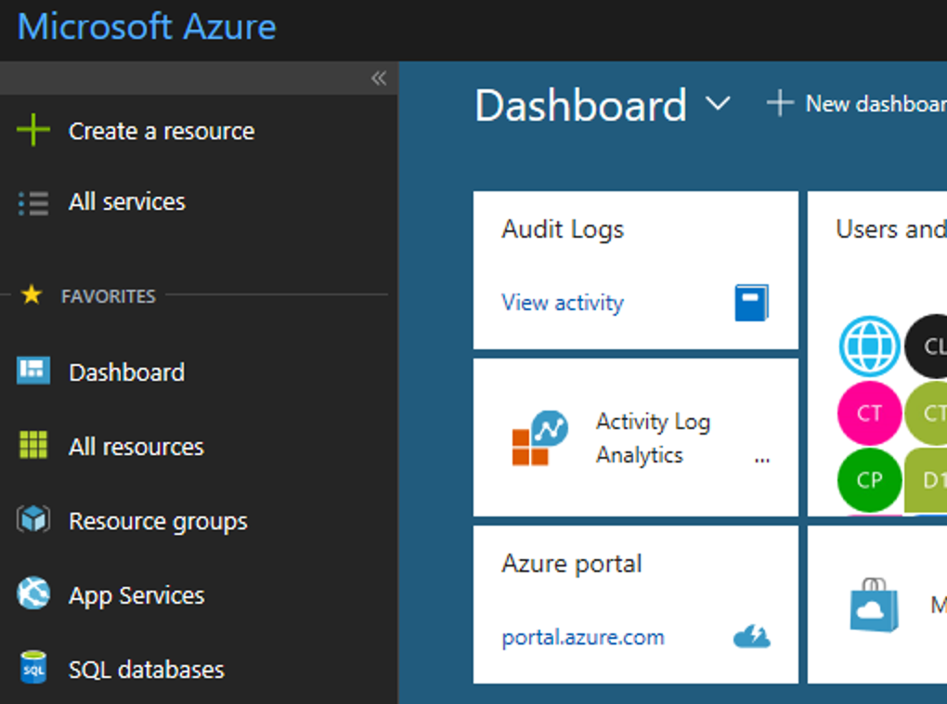
Secure and well-managed for IT
Productive
Govern
Secure
Policy management
Cost management
Security management
Threat protection
Hybrid
Azure portal
Configure
Protect
Intelligent
Update management, scripting
Automation, configuration
Backup and disaster recovery
Trusted
Monitor
App, infrastructure, and network monitoring
Log analytics and diagnostics
Notes:
Organizations need visibility, metrics and controls on every component to pinpoint issues efficiently, optimize and scale effectively, while having the assurance the security, compliance and polices are in place to ensure the velocity.
Starting in the middle with the Azure portal ---
- With Azure you get enterprise grade management capabilities built-in to the platform – all services and resources together in a single, easy-to-use portal. You can create dashboards, use the friendly search and intuitive menus, quick start resource templates, and more.
- With a single platform, you get integrated and interconnected tools and data, with unified metrics and alerts across your services. So you don’t have to go to different portals with different datasets.
- Using out-of-the-box tools (like Azure Advisor, Azure Service Health, and Cost Management + Billing), you can optimize and right-size your investment and get personalized recommendations to enhance your experience.
Looking at the 5 areas of security and management ---
Secure: While Azure is trusted and secure platform, you as a customer have your own security settings you need to manage. You also need to be able to protect your individual machines against threats and monitor the security posture of your system.
Protect: Your VMs and applications in the cloud need to be backed up and protected in the event of data loss. With disaster recovery from on-prem to the cloud, or from one cloud to another, you can avoid downtime and keep your applications up and running.
Monitor: Every operations manager and every developer needs to be able to see the health and performance of their applications, infrastructure, and network. And seeing insights across all three together in a single dashboard can save time and resources in troubleshooting and preventing issues in the future.
Configure: For managing Azure and hybrid workloads at scale, automation and configuration capabilities help you create runbooks to automate tasks, manage the configuration settings and track changes, and monitor and deploy missing updates. Additionally in Azure you can use PowerShell and Cloud Shell for command line scripting.
Govern: Many customers need a way to look across cloud resources to assess and enforce enterprise-wide standards and policy compliance for security and management. In addition, they need to manage and monitor costs for the cloud, not just in Azure but in other clouds too.
Lastly, Azure gives you the flexibility to manage your hybrid environments with most of these services. And you can choose which areas to invest more in, and how much to consume.
With Azure you have the flexibility to choose what and how to manage your IT.

Slide 11
Azure: Hybrid
The only consistent, comprehensive hybrid cloud
Productive
Azure
Cloud
Azure
DevOps
Azure Data Services
Azure Active Directory
Azure security & management
Hybrid
Platform
Data
Platform
Common
Identity
Security & Management
DevOps
Intelligent
Azure
Stack
Azure
DevOps
Server
SQL Server, MySQL,
PostgreSQL, NoSQL
Active Directory
Security & management
Trusted
Notes:
Hybrid strategy is about the continuum of capabilities across the offerings, it’s not just about the platform. Hybrid is more than just being able to move an application into the cloud. There are critical elements from identity, data, and security and management that have to be addressed.
You don’t have to be stuck in an all-or nothing choice – hybrid gives you the flexibility to move to the cloud when and how you want to.
Microsoft Azure offers consistency across your hybrid ecosystem:
Azure Stack – Azure in your data center. Same tools, same APIs.
Unified Dev/Ops - consistent CI/CD with Azure DevOps Server On-premises, including for containers and Kubernetes, and Azure DevOps in the cloud
Seamlessly distribute, manage, and analyze data across SQL Server and open-source databases in the data center, and the range of Azure Data Services.
Active Directory and Azure Active Directory enable one identity, access anywhere, directory sync
Integrate security and management

Slide 12





Azure Data Warehouse
Productive
Language APIs
Azure SQL Database
Hybrid
Azure
AI for every developer and every scenario
Intelligent
Azure Machine Learning
Cognitive Services
Trusted
Azure Bot Service
Notes:
Microsoft Azure: the cloud for intelligent solutions
In addition to having the traditional on-premises enterprise data tools—such as SQL Server—Azure provides data services that connect data to AI services.
This enables quick adoption of technologies, such as deploying a global mobile application that integrates with facial recognition services.
The ease of integration enables anyone to build solutions like that.
From bot frameworks to cognitive services, you can fundamentally change the way your business goes to market with Microsoft’s powerful AI platform

Slide 13




































More certifications than any cloud provider
GLOBAL
ISO 27001
ISO 27018
ISO 27017
ISO 22301
SOC 1 Type 2
Productive
SOC 2 Type 2
SOC 3
CSA STAR
Self-Assessment
CSA STAR
Certification
CSA STAR
Attestation
Hybrid
INDUSTRY
PCI DSS
Level 1
CDSA
MPAA
FACT UK
Shared
Assessments
FISC Japan
HIPAA / HITECH Act
Intelligent
HITRUST
GxP
21 CFR Part 11
MARS-E
IG Toolkit UK
FERPA
GLBA
FFIEC
REGIONAL
Argentina PDPA
EU
Model Clauses
UK
G-Cloud
China
DJCP
China
GB 18030
China
TRUCS
Singapore
MTCS
Australia
IRAP/CCSL
New Zealand
GCIO
Trusted
Japan My
Number Act
ENISA
IAF
Japan CS Mark Gold
Spain
ENS
Spain
DPA
India
MeitY
Canada
Privacy Laws
Privacy
Shield
Germany IT
Grundschutz
workbook
Notes:
Azure leads on trust. With more certifications than any other cloud provider and our ongoing security investments, compliance and trust is a primary commitment for Microsoft.
This is only a sample of our certifications. See the Azure Trust Center (see Resources) for full details.
Trusted
Compliance and trust is not an afterthought at Microsoft.
We are leaders in this space, and help set standards for global and federal organizations around the world.
Microsoft has been talking about trust in the cloud for a while and will continue to do so.
This is only a sampling of our compliance certifications, but we run the gamut.
Azure’s strengths are around security, privacy, and transparency around how we run the cloud.

Slide 14
Unique Intelligence
Productive
Security Technology
Unmatched security
Hybrid
$1B+ annual investments
Over 3500 security experts
Trillions of diverse signals
Secure Foundation
Intelligent
Trusted
Notes:
Azure provides you unmatched security.
Microsoft invests more than $1B a year and employs more than 3500 security experts to protect your information.
The secure foundation of Azure includes physical infrastructure, biometric security, and DDOS attack protections.
Built-in tools like Azure Security Center help you secure your environment across identity, network, threat protection, and management.
Finally, Microsoft offers threat protection which is informed by trillions of signals that we receive every day from more than 1.2B devices scanned, and over 750M Azure user account authentications.
This volume of data is unprecedented, and we provide you with our unique intelligence with threat protection so you can quickly mitigate any threats.

Slide 15
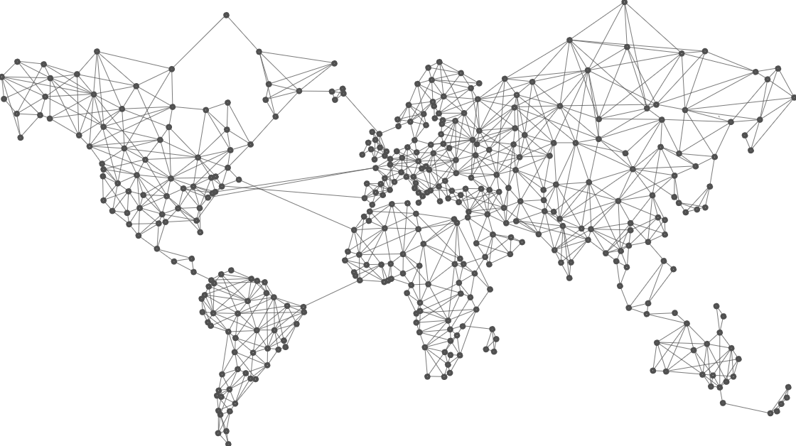
54
Azure regions
Notes:
Azure has 54 regions across the world. This is more than the other major public cloud providers combined.
The Microsoft network that connects all these regions is the second-largest fiber optic network on the planet. (The only larger one is a government network.)

Slide 16
The Modern Data Estate
Unify Data – Analyze in (Near) Real Time – Apply Intelligence
Unified Data
“We want to integrate and analyze all our data in one place”
Modern DW / Data Lake
Real-time Analytics
“We need to get insights from our data streams in real time”
Stream Processing
Advanced Analytics
“We need to apply intelligence to our data so we can learn and predict”
Notes:
The modern data estate unifies the organization’s data together in multiple formats: relational, semi-structured, and unstructured.
Modern data estates enable data to be analyzed in near real time, in addition to more traditional data analytics in batch mode and after the fact.
And – the modern data estate enables intelligence to be applied to data so that patterns, anomalies, and predictions can be found from the data using machine learning and AI technologies.

Slide 17





The Azure data landscape
SQL
Azure Data Factory
Azure Import/Export service
Azure SQL DB
Azure Cosmos DB
Azure SQL data warehouse
Azure Analysis Services
Power BI
>_
Azure CLI
Azure SDK
10 01
Azure Blob Storage
Azure Data Lake Store
Azure Data Lake Analytics
Azure HDInsight
Azure
Databricks
Azure ML
ML Server
Azure
Databricks
Azure IoT Hub
Azure event hubs
Azure Search
Azure Data Catalog
Azure Stream
Analytics
Azure HDInsight
Azure
Databricks
Bot service
Cognitive services
Kafka on Azure HDInsight
NSG
Azure ExpressRoute
Azure Active Directory
Azure network
security groups
Azure key
management service
Azure Monitor
Azure Functions
Visual Studio
Notes:
What is in Azure that we can use to build a modern data estate? Many, many services!
This is just a subset of all the Azure services available! Remember there are over 100 services in Azure. These are the data services, plus some cross-cutting enabling technologies at the bottom.
This is an eye-chart, but we’ll discuss several of these, and how they can fit together to build a modern data estate in the cloud. You will use several of these in the labs today.

Slide 18
Data Architectures
There are many well-established data architectures… for data warehousing, BI, stream processing, machine learning training and scoring, etc.
Today, we’re focused on a data estate which combines traditional batch analytics with stream analytics, and uses PaaS (managed) data services
More and more devices and sensors are coming online – which generate streams of data
We want unified analytics on all the data – batch/static as well as streaming
We also want to be able to react as quickly as possible to events in our data stream – i.e. in near real time
What are some scenarios for stream analytics?

Slide 19








Stream Analytics Scenarios
Real-time fraud detection
Fleet Management and Connected Cars
Click-stream analysis
Real-time Patient Monitoring
Smart grid
Customer Behavior in stores
IT Infrastructure and Networking monitoring
Real-time demand and Inventory Management
Notes:
Scenarios for near real-time stream analytics include
fraud detection (much more useful right when it’s happening than a day later!)
Connected vehicles – to monitor location, speed, vehicle health, and more
Patient monitoring, especially as demographics change the ration of caregivers to people receiving care
Customer behavior and sentiment – so organizations can act (or react) quickly when needed – e.g. a poor experience propagated on social media
Inventory management as shelf stock is depleted
And many more.

Slide 20
Data Architectures
Let’s start by looking at two well-established architectures that each do part of what we’re looking for
One for traditional data warehousing analytics
One for stream ingestion and stream analytics
These are not canonical – there are many reference architectures and many technologies
“There is no one right way” – there are ways that meet your needs and budget, follow good practices and established patterns, and enable you to grow. So these architectures are not the only way – but they are known and used.

Slide 21












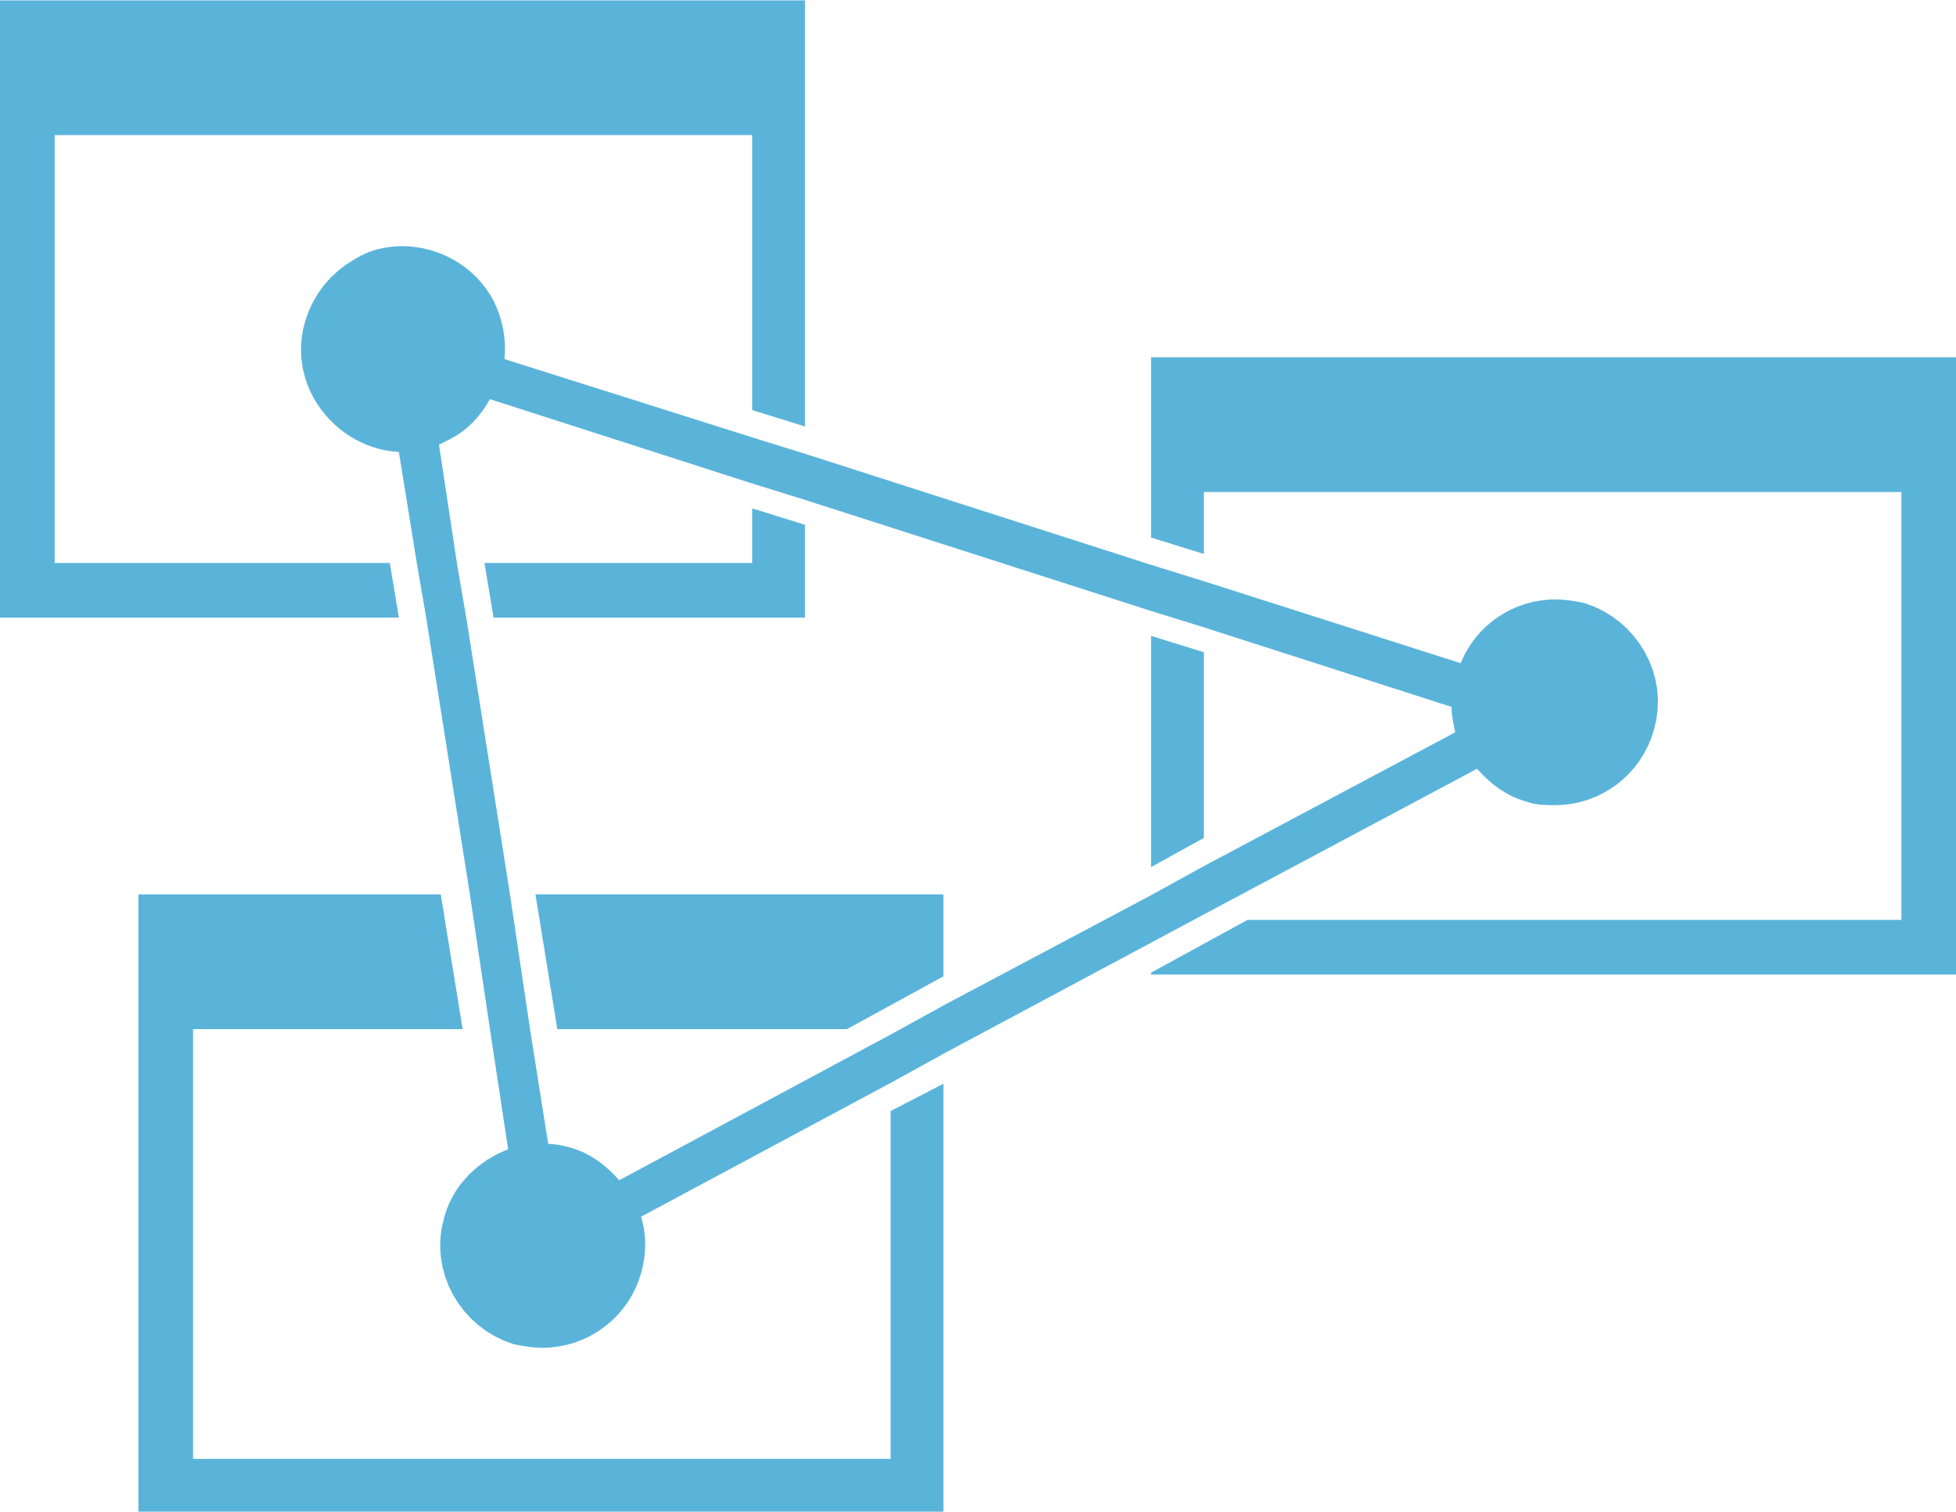
Data warehousing pattern in Azure
Loading and preparing data for analysis with a data warehouse
Data loading
Data factory
Azure Import/Export Service
Azure Data Box
APIs, CLI, and GUI tools
Applications
r
Ingest storage
Data processing
Serving storage
Logs, files, and media
(unstructured)
Data Lake Store
Azure Storage
Azure Databricks
Cosmos DB
HDInsight
Azure Data Lake Analytics
Azure SQL DW
Business and custom apps (structured)
Cosmos DB
SQL DB
AAS
Dashboards
Operational data
Notes:
In modern data warehousing, data may be collected from various sources including flat files that are uploaded to storage like Data Lake Store or Azure Storage, or the source data may come from applications that are writing to one more transaction databases.
These “ingest stores” form the source for the data that is processed and ultimately served to applications and dashboards either in a data warehouse or by an analytic store that gets its data from the data warehouse.
The modern data warehouse can serve two functions. It can participate in the data processing in addition to being the data store serving analytic clients.
On this diagram – remember, you can download this deck to look at these slides in detail – we see various stages and, in each stage, some technologies available on Azure that can be used there. We’re going to look at some of these technologies in greater detail, but let’s review the various stages.
Data loading is how we get data into Azure, and more specifically into our data estate.
We ingest data to storage. File storage can use standard Azure blob storage – or, in Azure, can also use Azure Data Lake Store, a store that is optimized for analytics workloads. There are also many choices for structured data storage in operational data stores, across both relational SQL and also NoSQL stores.
Data processing is where data is prepared for later use by various consumers. Here, we might cleanse the data to handle bad or missing data, or we might augment our data with missing data. In a modern data estate with advanced analytics, we might also call out to machine learning or AI services to extract insights from our data.
Processing stores data in serving storage. This layer provides data to consumers, which could be…. Applications, APIs, web apps, BI dashboards, mobile apps, and so on. There are multiple technology choices here also.
Again, this is one version of a well-established pattern. What’s missing from this pattern? Streaming data and a near real time analytics capability. Here, there is typically latency of hours to days after data is generated to when it is first processed and analyzed. While that works well for many analytic workloads such as financial reporting or historical analysis, as we saw on the previous slide there are many use cases where a near real time stream analytics capability can be very useful.

Slide 22


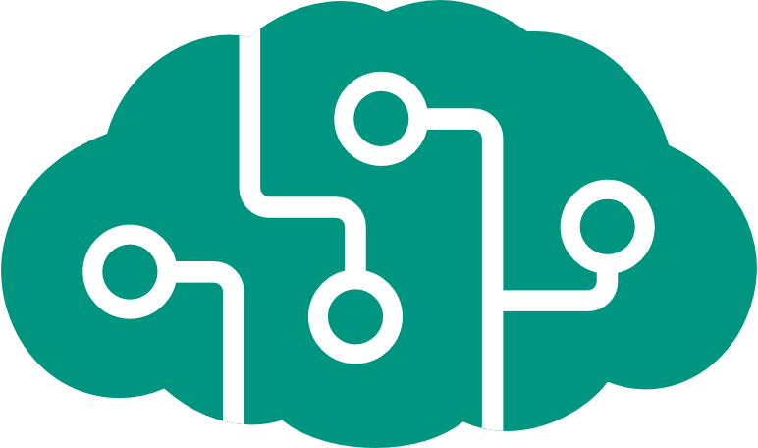








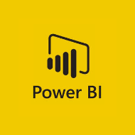


Stream analytics pattern in Azure
Analyze and enrich stream data as it is ingested
ML AND AI
AZURE ML
COGNITIVE SERVICES
AZURE DATABRICKS
(Spark ML)
STREAM INGESTION
STREAM ANALYTICS
REAL-TIME
APPLICATIONS
SENSORS AND IOT
(UNSTRUCTURED)
EVENT HUBS
IoT HUB
KAFKA on HDINSIGHT
STREAM
ANALYTICS
AZURE DATABRICKS
(Spark Streaming)
STORM on
HDINSIGHT
LONG-TERM STORAGE
REAL-TIME
DASHBOARDS
AZURE DATA LAKE STORE
AZURE SQL DB
COSMOS DB
AZURE STORAGE
Notes:
In a stream analytics pattern, stream data is ingested and is analyzed as it is received. The stream processing technology performs analytics on the stream data itself, for example by using a previously trained machine learning model to score each streaming data point, or by calling out to external services.
The stream is then served to consumers capable of using stream data, such as real-time apps or dashboards.
In the labs today, you’ll use the approach of calling out to a trained AI service exposed as an API, enriching the stream with the results from that AI service, then forwarding the stream to a real-time dashboard.
As we see here, while stream data is analyzed as it is ingested, it is also stored to long-term storage. This storage will enable us to later analyze our stream data along with our historical data, using our established batch analytics architecture, for unification of our data. There are many choices for storage, ranging from blob file storage to SQL, NoSQL, and data lake storage options.

Slide 23
Putting the architectures together
Let’s put the various elements of these architectures together
We want an architecture with:
Batch and stream ingest
Batch and stream storage
Batch processing and preparation
Stream analytics and scoring/enrichment
Serving to both traditional as well as streaming/real-time consumers
Also… unified storage lets us move toward a “data lake” where all our data is in one place, and we enable different constituencies (e.g. data scientists!)

Slide 24
STREAM INGESTION
STREAM ANALYTICS
EVENT
HUBS
IoT
HUB
KAFKA on HDINSIGHT
STREAM
ANALYTICS
AZURE DATABRICKS
(Spark Streaming)
STORM on
HDINSIGHT
REAL-TIME
APPLICATIONS
ML AND AI
SENSORS AND IOT
(UNSTRUCTURED)
AZURE ML
COGNITIVE SERVICES
AZURE DATABRICKS
(Spark ML)
REAL-TIME
DASHBOARDS
SERVING STORAGE
STORAGE
r
DATA PROCESSING
LOGS, FILES AND MEDIA (UNSTRUCTURED)
AZURE SQL
DATA WAREHOUSE
AZURE DATA
LAKE STORE
AZURE
STORAGE
AZURE
SQL DB
COSMOS DB
AZURE DATABRICKS
APPLICATIONS
APIs
DATA LOADING
AZURE ANALYSIS
SERVICES
BUSINESS / CUSTOM APPS
(STRUCTURED)
HDINSIGHT
AZURE DATA
FACTORY
AZURE IMPORT/
EXPORT SERVICE
AZURE
DATA BOX
CLI, TOOLS,
SDKs, APIs
AZURE SQL DB
AZURE DATA
FACTORY + IR/SSIS
REPORTS
DASHBOARDS
COSMOS DB
Notes:
Merging our two previous, partial architectures together gives us an architecture that does what we mentioned before. Let’s walk through it.
On the left, we have various data sources: both streaming (sensors, IoT) sources as well as our logs, files, media, and business and custom app sources of file and structured data.
We have three ingest paths into this architecture. At the top, we have stream ingestion. In the middle, we have direct to storage, where we have data that’s stored in what we can already use as a source. Then we have data loading for data sources we can’t directly use: this could be data stores that are inaccessible to us (e.g. behind a firewall or across a network connection) or data stores where we need to be careful about any additional processing load, preferring instead to load the data into our data estate and process it there.
We then have stream analytics. These technologies work with the data in our stream. Here, we could augment the data from reference data sources; we could perform calculations (such as aggregations over time windows), and we can call out to machine learning and AI services to derive insights from our data.
There are two output paths from stream analytics shown here. One goes to our storage; as we already discussed, we’ll want to keep our stream data (we could keep both the raw inbound stream data as well as what we process or calculate, of course) so that we can analyze it with all our other data. The other output path from stream analytics goes to our stream consumers: real-time apps and dashboards.
At the bottom, once our various data gets to storage, we have a processing layer after that. ETL (Extract, Transform, Load) activities typically happen here, as well as data cleansing, conformance, augmentation with reference data, and other data engineering activities. Of course, we can also all out to ML and AI services here to batch-score our data and derive insights from it.
From the data processing layer, the data goes to serving storage. As the term implies, this layer is there to “serve” consumers. Various data technologies can make sense here, and can be combined or can co-exist to meet multiple consumer needs.

Slide 25
A few points about our architecture
That is a complex-looking diagram!
However – remember we are showing multiple choices at each stage.
We are focusing on the data architecture. Not shown and not central today, but also very important:
Identity (authentication, authorization)
Security (auditing, data protection)
Operations (diagnostics, monitoring, alerting, automation, scaling)
Azure offers integrated approaches and technologies for each of those areas, that work with all the data technologies we’re looking at today.
Now let’s consider some of the choices shown in each of the stages.
Then we’ll get you building some of this!

Slide 26
Data Loading
DATA LOADING
AZURE DATA
FACTORY
AZURE IMPORT/
EXPORT SERVICE
AZURE
DATA BOX
CLI, TOOLS,
SDKs, APIs
Oh, and connectivity!
Azure Data Factory
Azure Import/Export Service
Azure Data Box
CLI, Tools, SDKs, APIs

Slide 27
Connectivity - Network data transfer
A side-by-side comparison of the capabilities and features
Requirement | Dedicated low latency (5 to 10 ms) | Secure transfer | Reliability
Public internet |  | X | Good
VPN |  | X | Good
ExpressRoute | X | X | Best
Notes:
There are three network connectivity options to Azure.
First, TLS connections over the public internet.
Second, VPN connections. Azure supports many leading VPN solutions and offers multiple virtual network appliances.
Third, dedicated ExpressRoute circuits over private connections. These do not go over the public internet, and offer the highest bandwidth and reliability, and the lowest latency.
Various Azure and other data transfer tools work over these connections. Examples include our azcopy and Storage Explorer utilities as well as many other commands and tools.

Slide 28
Command line tools and APIs to copy and manage data
A side-by-side comparison of the capabilities and features
 | Azure CLI | AzCopy | PowerShell | AdlCopy | Distcp | Sqoop | PolyBase | Hadoop command line
Compatible platforms | Linux, OS X, Windows | Linux, Windows | Windows | Linux, OS X, Windows | Hadoop/ HDInsight * | Hadoop/ HDInsight * | Windows with SQL Server instance, Azure SQL Data Warehouse | Hadoop/ HDInsight *
Copy to and from relational database | No | No | No | No | No | Yes | Yes | No
Copy to blob storage | Yes | Yes | Yes | No | Yes | Yes | Yes | Yes
Copy from blob storage | Yes | Yes | Yes | Yes | Yes | Yes | Yes | No
Copy to data lake store | No | No | Yes | Yes | Yes | Yes | Yes | Yes
Copy from data lake store | No | No | Yes | Yes | Yes | Yes | Yes | No
Optimized for Big Data | No | No | No | Yes ** | Yes | Yes | Yes *** | Yes
* Can be run from a command line or shell session invoked from Linux, OS X, or Windows
** AdlCopy is optimized for transferring Big Data when used with a Azure Data Lake Analytics account
*** PolyBase performance can be increased by pushing computation to Hadoop and using PolyBase scale-out groups to enable parallel data transfer between SQL Server instances and Hadoop nodes
Notes:
This slide compares various command-line tools in terms of features and sources and destinations. As you see, several of the Apache Hadoop tools are in this table.
AzCopy is a command-line tool. You can use this in lab 1 today (you’ll have a choice whether to use this or Storage Explorer, which we’ll come back to in a minute). AzCopy is cross-platform and also works in the Azure portal’s Cloud Shell (which means no download and local install!).
Remember – this deck is downloadable so don’t worry about deciphering all of the information here.

Slide 29
Graphical user interface tools to copy and manage data
A side-by-side comparison of the capabilities and features
 | Azure Storage Explorer | Azure Portal* | Azure Data Factory
Copy to and from relational database | No | No | Yes
Copy to blob storage | Yes | No | Yes
Copy from blob storage | Yes | No | Yes
Copy to data lake store | No | No | Yes
Copy from data lake store | No | No | Yes
Upload to blob storage | Yes | Yes | Yes
Upload to data lake store | Yes | Yes | Yes
Orchestrate data transfers | No | No | Yes
Custom data transformations | No | No | Yes
* Azure Portal in this case means using the web-based exploration tools for blob storage and data lake store. This excludes using the portal for other services, such as Azure Data Factory.
Notes:
In addition to various command-line tools we just saw, there are also graphical tools.
Azure Storage Explorer is cross-platform, so you can run it on either Windows or MacOS. This is one of the tools you can use in lab 1 today, if you like.
The Azure portal is a web app, so you can run that in any modern browser on any platform.
Azure Data Factory offers both a full in-browser development and management experience, as well as a Visual Studio extension.
All of these tools are constantly getting additional features and capabilities.

Slide 30
Physical data transfer
A side-by-side comparison of the capabilities and features
 | Azure Import/Export service | Azure Data Box
Form factor | HDDs or SSDs | Secure, tamper-proof, single hardware appliance
Microsoft manages shipping logistics | No | Yes
Integrates with partner products | No | Yes
Reduces administrative overhead of purchasing, preparing, and copying data to multiple drives | No | Yes
Notes:
Sometimes, data volumes are far too large to reasonably transfer to Azure over a network connection, even a multi-Gbps ExpressRoute. In these cases, there are physical data transfer methods: Azure Import/Export service and Azure Data Box.

Slide 31
Azure Data Factory
Build and orchestrate data pipelines
When you want… | Description
To orchestrate your data pipeline on-premises and in the cloud | Use Azure Data Factory to move data between both cloud and self-hosted environments. Data is compressed and transferred in parallel, and resilient to intermittent network issues through auto retry logic. You can connect on-premises data to cloud services to benefit from cloud services while keeping the business running with on-premises data.
To execute your SQL Server Integration Services (SSIS) packages in the cloud | When you provision an Azure and SSIS integration runtime (IR) in Azure Data Factory, you can deploy your SSIS packages to the runtime in Azure. Azure Data Factory orchestrates the SSIS package execution, which creates new opportunities for shifting existing on-premises data workflows to Azure.
To move your non-relational data to Azure for processing and transformation | Create and schedule data-driven workflows—pipelines—in Azure Data Factory that move your non-relational and unstructured data to Azure, then process and transform the data using compute services such as Azure HDInsight Hadoop, Spark, Azure Data Lake Analytics, and Azure Machine Learning.
Notes:
Azure Data Factory offers data movement orchestration with scheduled execution, retry logic, a large set of connectors to many data sources and sinks, and the ability to execute SQL Server Integration Services (SSIS) packages in a PaaS environment!
Today, ADF is a great data movement solution. Soon, ADF will gain significant additional data transformation capabilities.

Slide 32
Storage
STORAGE
AZURE DATA
LAKE STORE
AZURE
STORAGE
AZURE
SQL DB
COSMOS DB
Azure Storage
Azure Data Lake Store
Azure SQL Database
Cosmos DB

Slide 33
File storage requirements
Requirement | Comment
Capacity | Should be able to store TBs or PBs of data economically. Long term data stores should be able to store any number of objects and associated metadata.
Performance | Should be able to store the incoming data as fast as it arrives— should support high bandwidth, high throughput and low-latency writes.
Multiple Tiers | Should supports storing the data for extended periods of time i.e. months, years economically. So should have with multiple storage tiers (hot, cold, archival).
Multiple Object Sizes | Objects may be stored individually (could be as small as few tens of bytes) or as data sets that create large object (several GBs to TB’s).
Parallel I/O | Many analytics frameworks can consume large amounts of data in parallel, running on multi-node clusters.
HDFS Compatible | HDFS is supported—and often expected—by most big data analytics framework. It has emerged as the de-factor protocol for storing and sharing big data.
Encryption | Data may contain sensitive data (PII) and need to be encrypted during rest and in-flight.
Notes:
Consider several requirements when evaluating storage options, including capacity limits (both per object and total), performance and latency, data encryption both in transit and at rest, HDFS compatibility, and replication capabilities both for BC/DR as well as multi-geo scale.

Slide 34
File storage
A side-by-side comparison of the capabilities and features
 | Azure Data Lake Store | Azure Blob Storage
Purpose | Optimized storage for Big Data analytics workloads | General purpose object store for a wide variety of storage scenarios
Structure | Hierarchical file system | Object store with flat namespace
API | REST API over HTTPS | REST API over HTTP/HTTPS
Analytics workload performance | Optimized performance for parallel analytics workloads, high throughput and IOPS | Not optimized for analytics workloads
Size limits | No limits on account sizes, file sizes, or number of files | Max 2PB (US/EU) per account and 4.75 TiB per file
Geo-redundancy | Locally-redundant (multiple copies of data in one Azure region) | Locally redundant (LRS), globally redundant (GRS), and read-access globally redundant (RA-GRS). See Azure Storage replication for more information
Service state | Generally available | Generally available
Regional availability | Some regions | All regions
Notes:
Azure offers two main file storage services:
First, Azure Storage, which includes Blob as well as File (an SMB v3/CIFS service), Queue, and Table (a KVP service); storage tiers; different blob types; and many other features. Blob storage is the general-purpose object store for many scenarios. You will use Blob storage in the labs.
Second, Azure Data Lake Store (ADLS), which is a file system optimized for high-performance analytics workloads, and which has full WebHDFS compatibility layer for integration with the Hadoop ecosystem.
Blob Storage and ADLS are in the process of being united into one Azure storage system with the widest feature set and highest analytic performance. Today, ADLS v2 is a preview feature available for opt-in with Azure Storage. Please note that preview features are not recommended for production deployments, and are not supported like generally available (GA) Azure services.

Slide 35
Data storage
Azure offers MANY options for structured and semi-structured data storage. These include:
Service
Azure SQL Database | Relational SMP | Single and Managed Instance
Azure Database for MySQL, Postgres, MariaDB | Relational SMP
SQL Data Warehouse | Relational MPP
Cosmos DB | Multi-model: SQL, Graph, Table, Cassandra, MongoDB
Azure Databricks | Managed Spark++
HDInsight | Managed Apache Hadoop++ Stack
Azure Analysis Services | Managed OLAP | PaaS SSAS Tabular
Snowflake | Relational MPP | Early
SQL Server or other on IaaS VMs | Relational SMP, MPP etc.
Notes:
Azure offers many data storage services spanning relational SMP and MPP as well as NoSQL, OLAP, HDFS, and more. In addition to the PaaS options, there are also IaaS options, both in the Azure Marketplace and by bringing your own image (make sure to check licensing and support).
There are several managed relational options, including Azure SQL DB (based on the same engine as Microsoft SQL Server) and leading open-source offerings like MySQL, Postgres, and MariaDB. There is also Azure SQL Data Warehouse, currently leading on many industry benchmarks, and Snowflake for MPP data warehouse options.
Cosmos DB is Azure’s planet-spanning, multi-model NoSQL “and a lot more” database. It has features like automatic indexing, multi-master writes and conflict resolution, tunable consistency models, change feeds, data models including SQL, graph, and table, protocol compatibility with Cassandra and MongoDB, and much more.
Azure offers a managed Hadoop stack service, HDInsight. This service includes most Apache Hadoop capabitilies like Spark, Hive, Sqoop, Ambari, and many more. It also offers the ability to pause compute when not needed while maintaining data storage integrity: this is a great way to optimize cluster costs when clusters do not need to be operational 24/7.
Snowflake is also available on Azure since last summer!
Finally, of course there are IaaS (infrastructure as a service) options, both in the Azure Marketplace (such as SQL Server and Oracle VM images) as well as by bringing or installing your own software on Azure Linux or Windows Virtual Machines. Please make sure you check all licensing and support terms.

Slide 36
Stream Ingestion
STREAM INGESTION
EVENT
HUBS
IoT
HUB
KAFKA on HDINSIGHT
Azure Event Hubs
Azure IoT Hub
Kafka on HDInsight

Slide 37





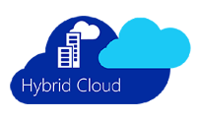
AZURE Options - How To Choose?
High-level guidance on choosing among the multiple Azure options
Consideration |  | Questions .. | Options …
 | Open Source | Are you familiar and comfortable using OSS? Already using OSS? Want to move to a OSS stack? | Then use Azure Kafka on HDInsight for ingestion and Azure Databricks Spark Streaming or Apache Storm on HDInsight for analytics
 | IoT Scenario | Is IoT your primary scenario i.e. does it need to track device state, handle millions of devices and bi-directional communication? | Then Azure IoT Hub is specifically designed for the IoT scenario.
 | Serverless Solution | Prefer a fully-managed, serverless solution that completely abstracts the underlying infrastructure? | IoT Hub, Event Hubs and Stream Analytics are all serverless solutions. Apache Kafka, Apache Spark and Apache Storm require HDInsight clusters.
 | Integration with Azure Services | Does your scenario require integration with other Azure services, specifically Azure Storage Services and Azure Machine Learning? | While all the options can integrate with other Azure services, some integrate more easily. Examples: Azure Stream Analytics can call a trained Azure ML Studio model Azure Stream Analytics connects directly to Azure Event Hubs and Azure IoT Hub without any coding. Azure Storm connects directly to Azure Kafka.
 | Single Integrated Stack | Do you prefer a uniform programming model across the entire stack, obviating the need to combine different products with different programming models? | Then Apache Spark is your best option -- it combines stream analytics, machine learning and interactive SQL in a unified programming model with a set of common set of abstractions.
 | Hybrid | Do you have a Hybrid scenario where you want to run your stream analytics solution either Azure, or on-premises or both? | Apache Storm, Apache Spark and Apache Kafka are available in Azure (as managed services) and on-premises as well.*
Notes:
on-premises they are not supported by Microsoft and the capabilities/features may not be identical.
These considerations apply both to Stream Ingestion as well as Stream Analytics services (in the next section).

Slide 38



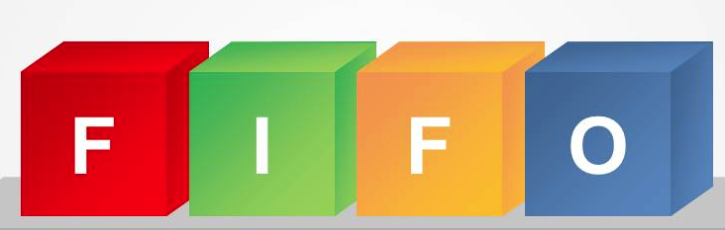

Ingestion – Requirements overview-1/2
General requirements for a stream ingestion service
Requirement |  | Description | Comments
Scale, Performance, Latency
 | Scale | For an ingestion service, capacity (or throughput) is measured in terms of the volume of streaming data. Usually measured in GBs/sec and messages/sec. Ideally, the capacity should increase linearly with the amount of hardware—compute, storage, networking—provided. There should be no practical ceiling to the capacity. | Capacity may also expressed as events/sec.
 | On-Demand | It should be possible to scale up or down the capacity dynamically without any downtime (i.e. without having to reboot or restart the service) | In case of serverless service, users should be able to just buy additional capacity units. In case of clustered services, users should be able to dynamically add/remove nodes to/from the cluster.
 | Latency | Latency is the time elapsed between an event entering the service (ingestion time) and the earliest time it is available to be processed/consumed. Ideally a service should be able to maintain constant low latency even at high loads. | For near-real time scenarios the latency should be in the order of milliseconds (double digits or low triple digits).
Message Consumption
 | Message Ordering | When desired, the service should be able to support ordered (FIFO) consumption of the ingested messages. In addition, consumers should be able to fetch messages out-of-order based on either messages id, message content, offsets in the queue etc. | When total ordering across all messages is not supported, at least a partial ordering over a subset of related messages should be supported. This often translates to ordering within partitions.
 | Message consumption models | Common message consumption models are request/reply, publish/subscribe, point-to-point queues and directed messaging. | At scale, for streaming scenarios, publish/subscribe is considered the preferred consumption model.

Slide 39







Ingestion – Requirements overview- (2/2)
Requirement |  | Description | Comments
 | Parallel Consumption | The service should enable multiple applications to consume the events in parallel. | It should also support parallel processing by applications that are consuming the events at different speeds.
 | Storage | Even after an event is consumed, often it needs to be stored in affordable long-term storage for analysis, reporting, visualization, training machine learning models or just archiving for regulatory purposes. The service should support easily moving the messages to long-term storage.
IoT-specific scenario requirements
 | Scale | In IoT scenarios, in addition to high throughput, the service should be able to connect to billions of devices. There should be no practical upper limit on the number of devices.
 | Bi-directional communication from/to devices | The service should support bi-directional communication (device-to-cloud and cloud-to-device).
 | Device State Management | The service should enable the state of the devices to be queried and set even when the devices are not connected. This implies that the state should be stored locally.
 | Device Protocols | A service should support multiple messaging protocols so it can connect to, and ingest data from, a wide variety of devices and streaming sources. | Common messaging protocols are AQMP, MQTT, STOMP, XMPP and HTTP/S. While a service may not support all protocols, intermediate connectors or gateways should be available.
 | Security | The service should support per-device security: authentication, authorization and revocation.

Slide 40
Apache Kafka on HDInsight

Slide 41

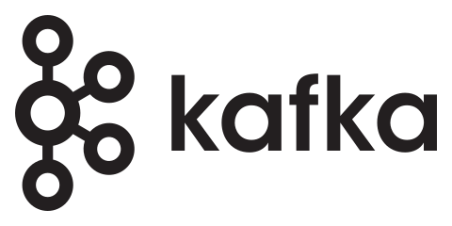
Apache Kafka on HDInsight
A open-source, scalable, stream ingestion platform offered as managed service on Azure HDInsight
Azure: Only public cloud to offer Apache Kafka as a managed service.
Can be provisioned directly from the Azure Portal
Apache Kafka is one of the seven HDInsight Cluster Types.
Clusters can be scaled within minutes
99.9% SLA
No additional charge for running Kafka clusters
Out-of-box management using Azure management tooling
Notes:
Offers managed rebalance of replicas and partitions across Azure update domains and fault domains for high availability of Kafka partitions on environments with a multidimensional view of a rack. See the open-source tool here (https://github.com/hdinsight/hdinsight-kafka-tools)
Azure is the only public cloud to offer Apache Kafka as a managed service.
Apache Kafka is one of the (7) HDInsight Cluster Types.
Can be provisioned directly from the Azure Portal (like the other cluster types).
You can choose from a wide range of Azure machine types for the Apache Kafka cluster nodes.
Offers a 99.9% SLA
This includes installation, configuration, and management of open source components
HDInsight additionally provisions and monitors a Zookeeper quorum as part of the cluster shape
There is no additional charge for running Kafka clusters
Clusters can be scaled within minutes HDInsight takes care of provisioning the new nodes.
Out-of-box management using Azure Operations Management Suite (OMS)

Slide 42
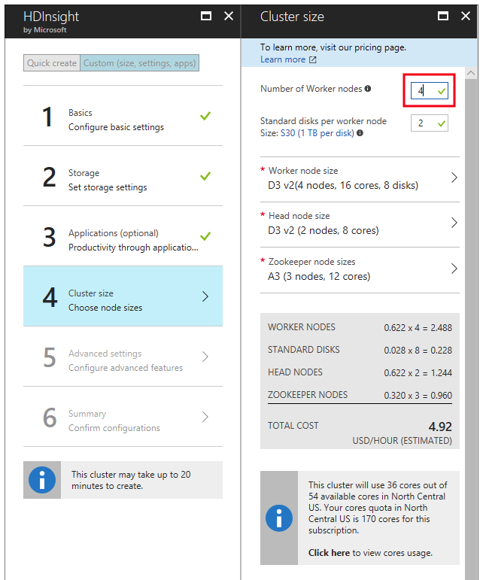
Provisioning Apache Kafka on HDInsight
A typical HDInsight Kafka cluster consists of:
3 or more worker nodes (at least 3 for data high availability)
2 head nodes (for redundancy)
3 Zookeeper nodes
Kafka is I/O heavy, so Azure Managed Disks are used – for high throughput and more storage per node.
Can deploy Apache Kafka on HDInsight clusters with managed disks straight from Azure portal.
Disks/node can be configured during HDInsight cluster creation (up to 16 TB per node)
Notes:
A typical HDInsight Kafka cluster consists of:
3 or more worker nodes (at least 3 for data high availability)
2 head nodes (for redundancy)
3 Zookeeper nodes
Kafka is I/O heavy, so Azure Managed Disks are used to provide high throughput and provide more storage per node.
Managed disk can be either Standard (HDD) or Premium (SSD). Premium disks are used with DS and GS series VMs.
Users can deploy Kafka clusters with managed disks straight from Azure portal, with no signup necessary.
The number of disks used per node can be configured during HDInsight cluster creation (up to 16 TB per node)

Slide 43






Kafka on HDInsight–Spark & STORM Integration
Direct Communication
Apache Kafka on HDInsight: No direct connector to Apache Storm/Spark on HDInsight.
However, samples are provided:
Use Spark Structured Streaming with Kafka on HDInsight
Use Apache Kafka with Storm on HDInsight
Virtual Network
Internet Traffic
HDInsight public gateway
Direct Communication
Virtual Network
Internet Traffic
HDInsight public gateway
Notes:
NOTE: The Kafka service is limited to communication within the virtual network. Apache Kafka on HDInsight does not provide access to the Kafka brokers over the public internet. Anything that talks to Kafka must be in the same Azure virtual network as the nodes in the Kafka cluster as shown in the figures.

Slide 44

Spark streaming - Apache Kafka Integration
Spark Streaming provides a unified batch and streaming API to view Kafka data as DataFrames
Read from Kafka
// # Construct a streaming DataFrame that reads from topic1
val df = spark .readStream
.format("kafka")
.option("kafka.bootstrap.servers", "host1:port1,host2:port2") .option("subscribe", "topic1")
.option("startingOffsets", "earliest")
.load()
Kafka Records
Key | Value | Topic | Partition | Offset | timestamp
[binary] | [binary] | “topic A” | 0 | 345 | 121322131
[binary] | [binary] | “topic B” | 3 | 2912 | 12323344
Write to Kafka
//# Write key-value data from a DataFrame to a Kafka topic specified in an option
query = df
.selectExpr( "CAST(userId AS STRING) AS key", "to_json(struct(*)) AS value" )
.writeStream
.format("kafka")
.option("kafka.bootstrap.servers", "host1:port1,host2:port2")
.option("topic", "topic1")
.option("checkpointLocation", "/path/to/HDFS/dir")
.start()

Slide 45
Choosing APACHE KAFKA On HDInsight
When Apache Kafka can be a good option
When You Want .. | Description
A proven ingestion service | Apache Kafka is the de-facto leader in the big data stream ingestion space. It is used by the who-is-who of the modern internet companies. Powered by Apache Kafka lists companies using Apache Kafka.
A hybrid, multi-cloud solution with choice of deployment models | You can run Apache Kafka in multiple ways: on-premises, as a managed service on Azure, as an IaaS solution on Azure VMs or even on other public clouds (including AWS and Google Cloud Service).
An open-source solution | Kafka is an open-sourced product licensed under the Apache License 2.0. It is implemented in Java and Scala.
A highly reliable fault-tolerant scalable service | Kafka is reported to scale to handle ingestion rates of 1.1 trillion messages a day at LinkedIn. Kafka is a horizontally scalable service—you can scale Apache Kafka on HDInsight by dynamically adding more nodes to the cluster.
Extensibility, with support for large number of data source and sinks | Kafka Connect is a tool for scaleably and reliably streaming data between Apache Kafka and other systems. It makes it simple to quickly define connectors that move large collections of data into and out of Kafka. Currently there exist pre-built Connects to a number of data sources. See list. You can extend this list by easily building custom connects as well.

Slide 46
Azure Event Hubs

Slide 47
Azure event hubs
A highly scalable, fully managed, telemetry ingestion service
Azure Event Hubs – Scale and Performance
Partition
Event hubs
Reader
Input Capacity: 1 MB/sec per TU*
Output Capacity: 2 MB/s per TU*
Latency: 50ms Avg, 99th % < 100ms
Events/second: 1K
Max message size: 256 KB.
Event Publisher
Event
Consumer
Partition
Reader
Partition
Reader
*In Azure Event Hubs, capacity is purchased in terms of Throughput Units (TU). For higher capacity more TUs can be purchased.
Notes:
Azure Event Hubs Quotas and Limits: https://docs.microsoft.com/en-us/azure/event-hubs/event-hubs-quotas

Slide 48
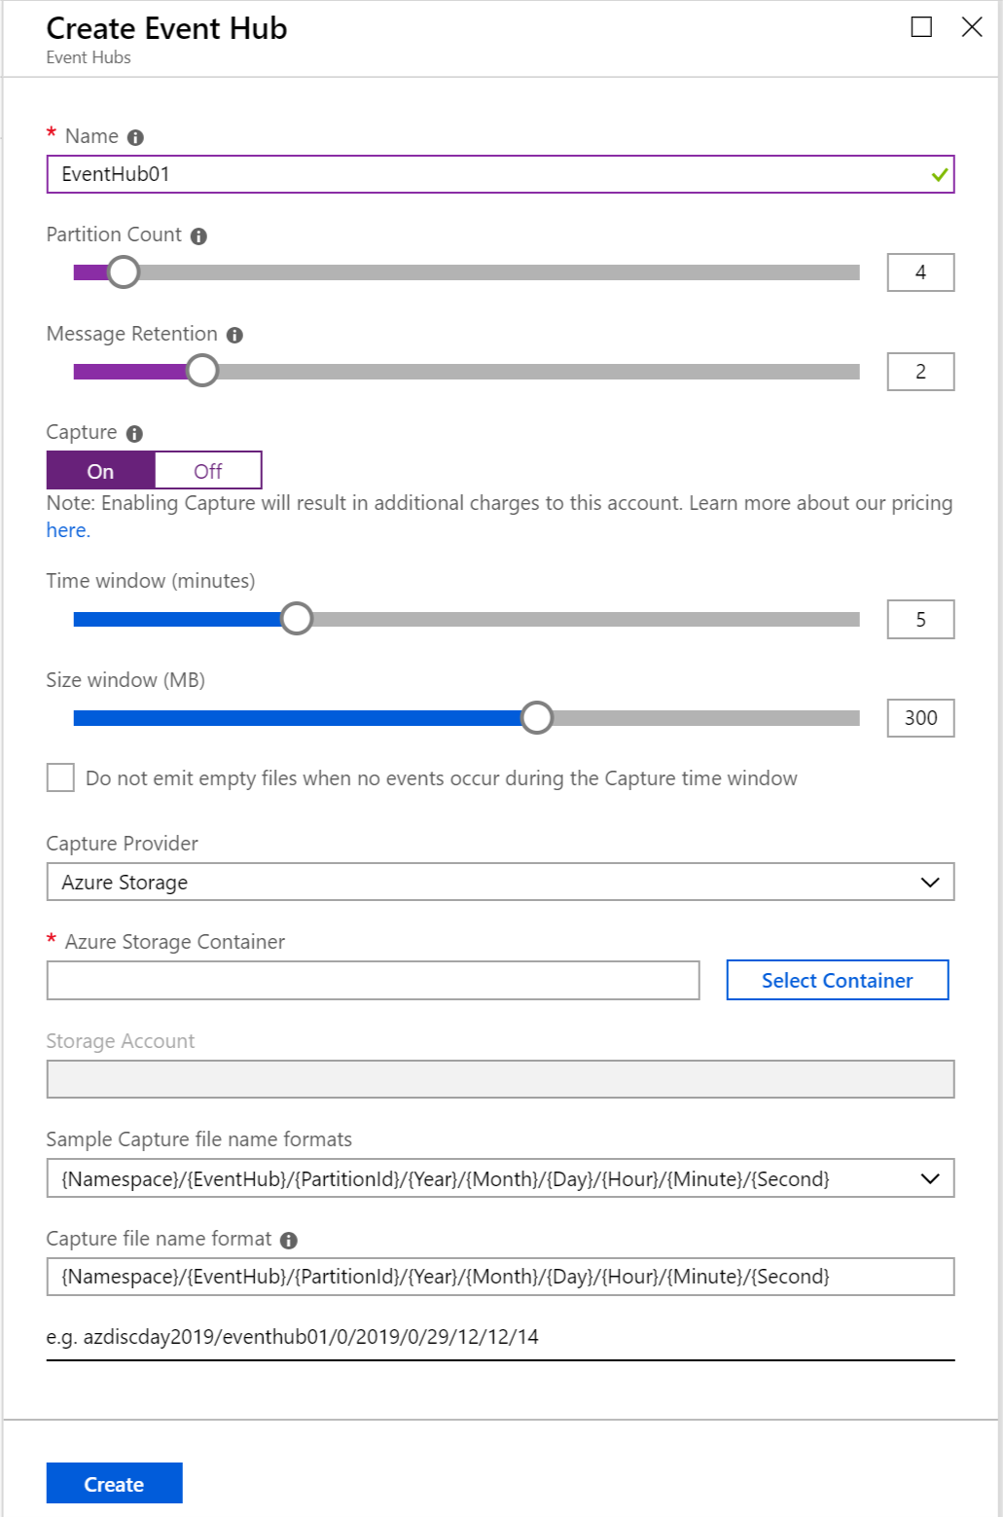
Azure event hubs- Capabilities overview
Based on the concept of Event Producers and Consumers
Producers send data to an event hub via AMQP 1.0 or HTTPS
Consumers read event data from an event hub via AMQP 1.0.
SAS tokens: Identifies and authenticates the event publisher.
Data can be captured automatically in either Azure Blob Storage or Azure Data Lake Store (in AVRO format).
Data stored for 24 hours by default
84 GB storage included per Throughput Unit (TU)
Notes:
Based on the concept of Event Producers and Consumers
Producers send data to an event hub. Connect via AMQP 1.0 or HTTPS
Consumers read event data from an event hub. Connect via AMQP 1.0.
SAS tokens: Identifies and authenticates the event publisher.
Data can be captured automatically in either Azure Blob Storage or Azure Data Lake Store. Captured data is stored in AVRO format.
Data is stored by default for 24 hours. 84 GB of storage is included per Throughput Unit (TU)

Slide 49
Choosing EVENT HUBs
When Azure Event Hubs can be a good option
When You Want .. | Description
To automatically scale capacity | Auto-inflate enables you to start small with the minimum required throughput units. It then scales automatically to the maximum limit of throughput units, depending on the increase in traffic.
A serverless solution | Azure Event Hubs is a serverless service. Note: Your ability to fine tune the performance is limited.
To integrate easily with Azure Stream Analytics | You can configure Azure Events Hubs as a streaming data input to Azure Stream Analytics via the Azure Portal without any coding.
A low-latency ingestion service | Azure Event Hubs latency can be < 50ms Avg, with 99th % < 100ms*.
To store ingested data in Azure Blob Storage or Azure Data Lake Store | Azure Events Hubs has built in integration with these two Azure storage services.
Notes:
* Note that other service may have a similar latency, but there are no publicly available numbers.

Slide 50
IoT Hub

Slide 51
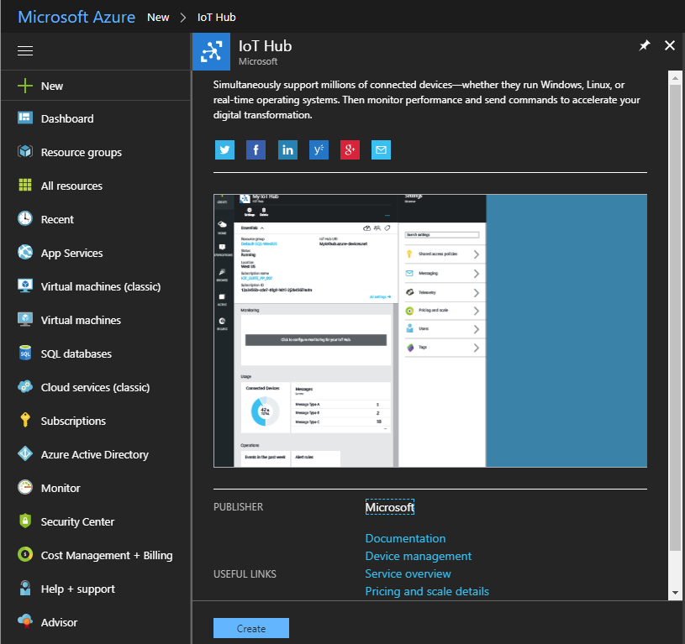
Azure IoT Hub
A fully managed service to connect, monitor and manage billions of IoT assets
Serverless Azure service.
Billions of devices and assets
Supports Linux, iOS, Android, Linux, Windows and real-time operating system (RTOS) devices.
Supports reliable bi-directional communication (device-to-cloud and cloud-to-device)
Ingests data in real-time
Can manage IoT devices at scale with device management
Extends the power of the cloud to edge devices with Azure IoT Edge
Notes:
A fully-managed Serverless Azure service.
Scales to support billions of devices and assets
Supports Linux, iOS, Android, Linux, Windows and real-time operating system (RTOS) devices.
Supports reliable bi-directional communication (device-to-cloud and cloud-to-device)
Ingests data in real-time
Can manage IoT devices at scale with device management
Extends the power of the cloud to edge devices with Azure IoT Edge

Slide 52


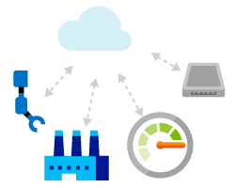


Azure IoT Hub – Capability Overview
Per device security: IoT Hub lets you set up individual identities and credentials for your connected devices. This helps maintain the confidentiality of cloud-to-device and device-to-cloud authentication. You can also selectively revoke the access rights to specific devices as needed.
Device Monitoring and Management: Administrators can remotely maintain, update, and manage IoT devices at scale from the cloud. Service personnel often do not have to travel to asset location. It also monitors device connectivity.
Provisioning: With IoT Hub Device Provisioning Service you can register and provision devices with zero-touch in a secure and scalable way. Devices can be provisioned via the Azure portal.
Bi-directional Communication: IoT Hub lets you establish bi-directional communication between Azure and IoT devices. Use device-to-cloud telemetry data to understand the state of your devices and assets. In cloud-to-device messages, reliably send commands and notifications to your connected devices—and track message delivery with acknowledgement receipts. Device messages are sent in a durable way to accommodate intermittently connected devices.
Device Twins: Using Device twins, you can store, synchronize, and query device metadata and state information. Device twins are JSON documents that store device state information like metadata, configurations, and conditions. IoT Hub maintains a device twin for each device that you connect to IoT Hub.
Route Messages: IoT Hub enables you to define message routes based on routing rules to control where your hub sends device-to-cloud messages. Routing rules do not require you to write any code, and can take the place of custom post-ingestion message dispatchers

Slide 53
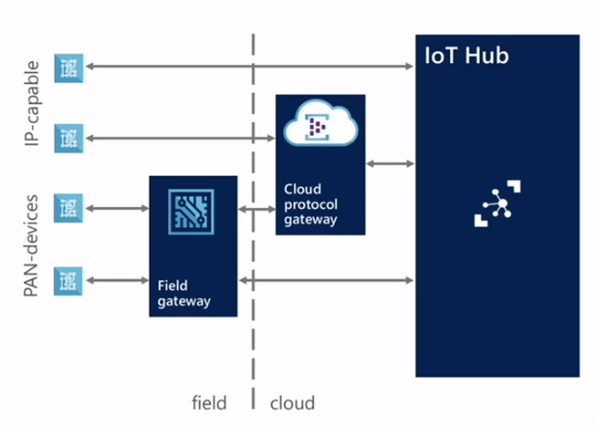
Azure IoT Hub – Connecting to Devices
Azure IoT Hub can connect to device with different capabilities
Support devices that are constrained in communication protocols, network resources and power resources.
Device Connectivity:
IP-capable devices can connect directly to IoT Hub
Or use a Cloud Protocol gateway (for protocols other than HTTPS or AMQP)
Non IP-capable devices (Personal Area Network (PAN)) can connect via Field gateways that provide the necessary protocol translation
Devices can be intermittently or continuously connected.
Note that all ‘gateways’ are conceptual, not a Microsoft product.

Slide 54
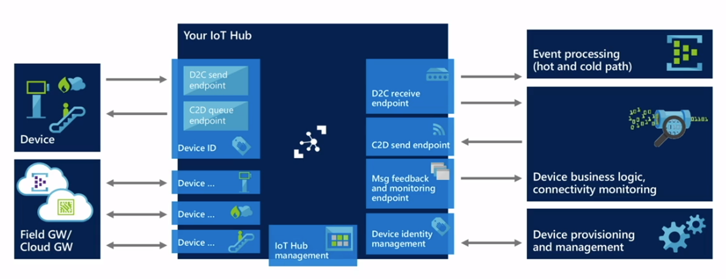
Azure IoT Hub ENDPOINTS
Azure IoT Hub exposes several endpoints for different purposes
Some Important endpoints
Full list of all the IoT Hub endpoints: https://docs.microsoft.com/en-us/azure/iot-hub/iot-hub-devguide-endpoints

Slide 55
Azure IoT Hub SDKS
Three categories of SDKs for working with IoT Hubs: Device, Service and Azure IoT Edge
Enable you to build apps that run on your IoT devices. These apps send telemetry to your IoT hub, and optionally receive messages from your IoT hub.
SDKS available for: .NET, Java, Node.js, Python and C
Device SDK
Service SDK
Enables you to manage your IoT hub, and optionally send messages to your IoT devices.
SDKS available for: .NET, Java, Node.js, Python and C
Azure IoT Edge
Enables you to build gateways for devices that don't use one of the supported protocols. Gateways can also process messages on the edge.

Slide 56
Choosing Azure IoT HUB
When IoT Hub can be a good option
When You Want .. | Description
A solution for primarily an IoT scenario | IoT Hub is specifically optimized for IoT scenarios. It can register, communicate with and manage billions of devices.
A serverless solution | IoT Hub is a fully-managed serverless solution — there are no VMs or clusters to provision.
Bi-directional communication | IoT Hub supports both cloud-to-device and device-to-cloud communication
To manage billions of devices | The device twins feature lets you store, query and set the state of devices, making it easy for applications to manage devices.
Per-device security | Azure IoT Hub lets you set up individual identities and credentials for your connected devices
To connect easily to Azure Stream Analytics | Azure Stream Analytics can be configured to connect to Azure IoT Hub via the Azure Portal with no coding.
To store messages easily in Azure Blob Storage | Via the Azure Portal, without any coding, you can store Azure IoT Hub messages to Azure Blob Storage (using the ‘route’ feature).

Slide 57
Stream ingestion (1/2)
 | Apache Kafka on HDInsight | Azure Event Hubs | Azure IoT Hub
Open-Source | Yes | No | No
Serverless Service | No | Yes | Yes
Hybrid (cloud and on-prem) | Yes | No | No
Protocols supported | HTTP REST | AMQP, HTTP REST | MQTT, AMQP, HTTPS and Azure IoT protocol gateway for custom protocols
Replication and reliability | Manually configured with tools like MirrorMaker | Relies on underlying Azure Storage | Relies on underlying Azure Storage
SLA | 99.9% | 99.9% | 99.9%
Scaling | Limited by number and type of nodes in the HDInsight cluster provisioned | Limited by number of Throughput Units | Limited by number of IoT Hub Units
Throttling | No, explicit throttling | Yes, when TU limits are reached | Yes, when IoT Hub Unit limits are reached
Message Size | No Limits | 256 KB | 256 KB
Message Ordering | Yes, Ordered within a partition | Yes, Ordered within a partition | Yes, within a partition
Long-term Storage | Can automatically store in Azure Managed Disk. Number of disk has to be explicitly specified during cluster creation. | Can automatically store in Azure Blob Storage or Azure Data Lake Store. | Can automatically store in Azure Blob Storage (using ABS as an endpoint)
Notes:
There are three major PaaS streaming ingestion options on Azure. There are also IaaS options, but we’ll focus on PaaS today.
HDInsight is the managed Hadoop stack service on Azure, with capabilities including Spark and many other tools including Apache Kafka.
Azure Event Hubs is a managed, high-throughput stream ingestion service. You will use Event Hubs in the labs today.
Azure IoT Hub is a full-featured, managed IoT service offering bi-directional capabilities, device management, and many more capabilities.

Slide 58
Stream ingestion (2/2)
 | Apache Kafka on HDInsight | Azure Event Hubs | Azure IoT Hub
Pricing Model | Pay for number and type of nodes in the HDInsight cluster and duration of use. | Pay per TU | Pay per IoT Hub Unit
IoT Scenario
Scales to Billions of devices | No | No | Yes
Bi-directional Communication | No | No | Yes
Per-device security | No | SAS Tokens to identify devices | Yes
Device State Management | No | No | Yes
Route Messages to multiple end-points | No | No, requires coding | Yes, up to 10 custom endpoints are supported.
Integration With Stream Analytics Service
Azure Stream Analytics | No, not built-in, requires coding; samples provided | Yes, built-into Azure Stream Analytics. No coding required; via Azure portal. | Yes, built-into Azure Stream Analytics. No coding required; via Azure portal.
Spark Streaming | Yes, integration available | Sample code available
Apache Storm on HDInsight | Kafka Spout for Storm available | Not built-in, requires coding | Not built-in, required coding
Notes:
Additional details about the three stream ingestion technologies.

Slide 59
Stream Analytics
STREAM
ANALYTICS
AZURE DATABRICKS
(Spark Streaming)
STORM on
HDINSIGHT
Azure Stream Analytics
Azure Databricks
Storm on HDInsight

Slide 60




Stream analytics – Requirements overview(1/2)
General Requirements for a stream analytics service
Requirement |  | Description | Comment
 | Scalability | The service should be able to scale to handle increasing volumes of incoming streaming data, typically measured in events/second. Regardless of the rate of the streaming data, every event should be processed within the desired window of time. | In case of serverless service, users should be able to just buy additional capacity units. In case of clustered services, users should be able to dynamically add/remove nodes to/from the cluster.
 | Fault Tolerance and high availability | The service should be tolerant to hardware and software failures. This is critical in real-time scenarios where events may lose their value if not processed within a certain point in time. So merely recovering from an outage may not be sufficient, the service has to be continuously available.
 | Windowing Support | Windowing is an essential abstraction for streaming applications. A common requirement is to perform some set-based operation such as aggregation (count, average, min, etc.) over the subset of events that arrive within a specified period of time. Other Windowing operations include Join, Union, Split, Filtering and Transformation. | Common types of Windows are Tumbling Window, Sliding Window and Hopping Window.
 | Query Language | Does the service provide a higher-level language to analyze a set of events? Or does the service only support event-at-a-time processing? | Azure Stream Analytics and Spark Streaming provide a SQL-like language to process sets/batches of streaming data.
 | Processing Guarantees | This defines the types of guarantees that the service can provide when there are failures while processing the events. Common guarantees are: At least once, Exactly once, At most once. | Note: Often times the ability of the streaming service to provide this guarantee depends on the capabilities of the event source, like ability to replay streamed events.

Slide 61




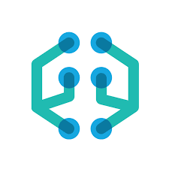
Stream analytics – Requirements overview (2/2)
General Requirements for a stream analytics service
Requirement |  | Description | Comment
 | Unified Programming Model | Often a streaming application also needs to interact with batch data, do interactive analysis, do machine learning etc. A unified API and programming model can improve developer productivity as well as performance. | Apache Spark Streaming in the best option for this requirement.
 | Input Sources | The service should be able to consume data from common ingestion services such as Kafka, HDFS and cloud storage services. | If the source supports consumption in parallel, the connector must support that. The underlying details of how to consume the events in parallel should, as far as possible, be transparent to the streaming application.
 | Output Sinks | The service should be able to store the output of an analysis in another ingestion service (for further analysis), or in a long-term storage service for batch analysis.
 | Extensibility | It should be possible to extend the built-in analytics capabilities of the service with custom code implemented either as libraries, user-defined functions or scripts. | Extensibility can also refer to the ability to add custom source and sinks. This is important when the streaming data has to be joined with “reference data” that may be in source that is not supported out of the box.
 | Machine Learning (ML) Integration | A common pattern in streaming applications is to ‘score’ every event of an incoming stream against a pre-trained, deployed machine learning model The service should support easily connecting to a deployed pre-trained model and submitting events to it for scoring.

Slide 62
Azure Stream Analytics

Slide 63



What is Azure Stream Analytics?
Fully managed real-time analytics
Mission critical reliability and scale
Enables rapid development

Slide 64


Stream Analytics—Capabilities Overview
Easy Analytics
Monitoring and Trouble Shooting
Rich temporal and sequential analytical models
Dynamic, flexible query and data source management
Familiar SQL-like syntax for improved developer productivity
Health and KPI metrics of the cluster
Notifications and alerting
Drill-down through explorative troubleshooting
Logging and tracing infrastructure for user code
Policy based metadata management
High Reliability
Scale
Highly resilient system through redundant instances
Guaranteed, exactly once event processing
Multi-tenant Azure service with flexible, elastic capacity
Federated scale out collection and analytics
Auto managed – just specify resources to be allocated

Slide 65

Integration with Azure EVENT HUB & IoT Hub
Azure Stream Analytics has built-in, first class integration with Azure Event Hubs and IoT Hub
Streaming Data
Data from Azure Event Hubs and Azure IoT Hub can be sources of Streaming Data to Azure Stream Analytics.
The connections can be established through the Azure Portal without any coding. (see next slide)
Azure Blob Storage is supported as a source of Reference Data.
Azure Stream Analytics supports compression across all data stream input sources (Event Hubs, IoT Hub, and Blob storage).
Azure Event Hubs
Streaming Data
Azure IoT Hub
Azure Stream Analytics
Reference Data
Azure Blob Storage

Slide 66
Choosing Azure STREAM ANALYTICS
When Azure Steam Analytics can be a good option
When You Want .. | Description
An serverless solution | Azure Stream Analytics is a serverless solution — no need to provision VMs or clusters.
Easy Scaling | Azure Stream Analytics can be scaled easily and dynamically by simply purchasing additional Streaming Units.
Windowing Support | Out of the box Azure Stream Analytics supports Sliding Windows, Hopping Windows and Tumbling Windows.
Querying using SQL | Azure Stream Analytics offers a SQL-like query language for performing transformations and computations over streams of events.
Exactly once processing | All input events are processed and only processed once so the output results are complete, and there is no duplicate output. Azure Stream Analytics guarantees exactly once delivery up to the output adapter that writes the output events.
Integration with Azure ML | Stream Analytics can easily send streaming events to an Azure model deployed as a web service. It supports “Azure ML” as a built-in function type that can be specified in the Portal.
Integration with Azure IoT Hub and Event Hub | Azure Stream Analytics can be configured via the Azure Portal to consume data from Azure IoT Hub and Azure Event Hubs. No coding is required.

Slide 67
Apache Spark Streaming with Azure Databricks

Slide 68
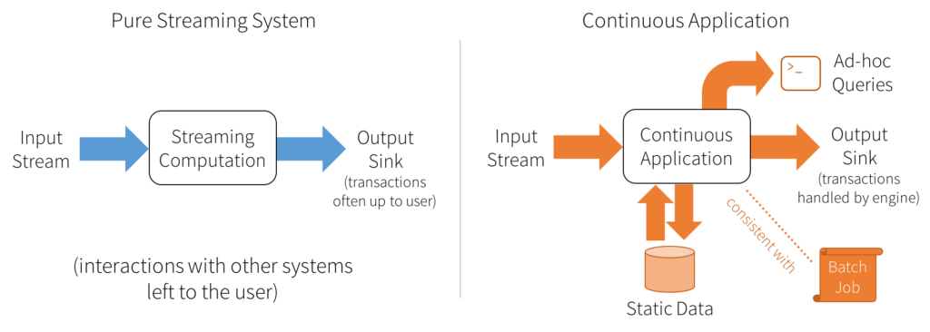
Spark Structured Streaming Overview
A unified system for end-to-end fault-tolerant, exactly-once stateful stream processing
The simplest way to perform streaming analytics is not having to reason about streaming at all!
Unifies streaming, interactive and batch queries—a single API for both static bounded data and streaming unbounded data.
Supports streaming aggregations, event-time windows, windowed grouped aggregation, stream-to-batch joins.
Features streaming deduplication, multiple output modes and APIs for managing/monitoring streaming queries.
Also supports interactive & batch queries:
Aggregate data in a stream, then serve using JDBC
Change queries at runtime
Build and apply ML models
Built-in sources: Kafka, File source (json, csv, text, parquet)
App development in Scala, Java, Python and R.
Develop
Continuous Applications
That need to interact with batch data, interactive analysis, Machine Learning ….
Notes:
Addresses many of the pain points with DStreams.
Enables the development o f “Continuous Applications” that need to interact with batch data, interactive analysis, ML etc.

Slide 69
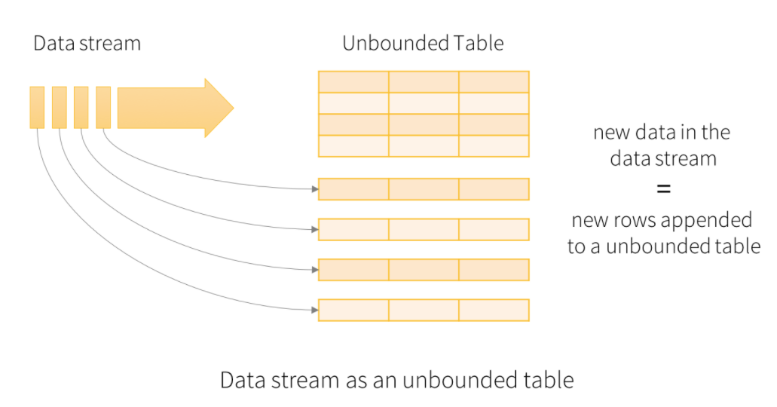
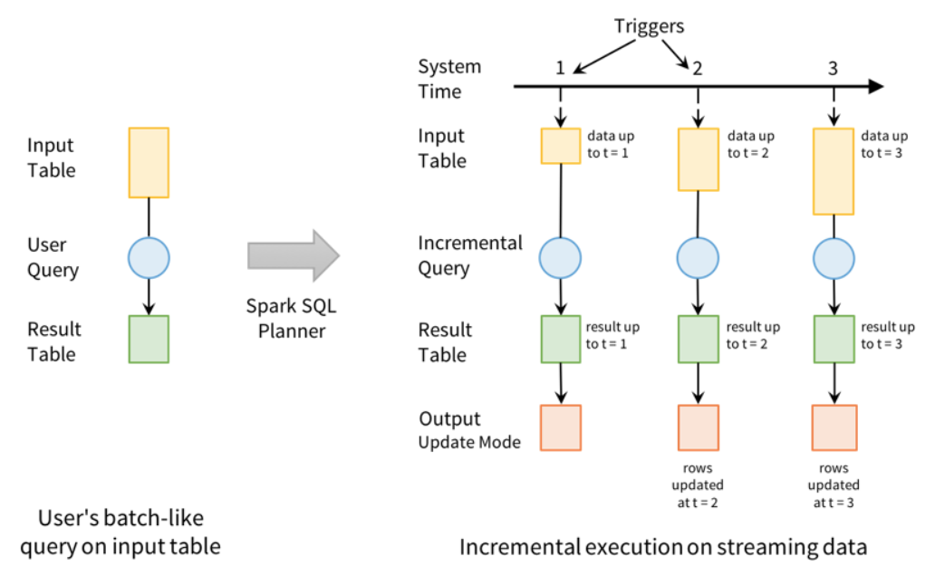
Concept: Unbounded tables
Built on Spark SQL, Structure Streaming treats Streams as Unbounded Tables
Key Ideas:
Create a stream processing model similar to batch processing model
Express streaming computation as standard batch-like query as on a static table … Spark runs it as an incremental query on the unbounded input table
Treat a live data stream as a table that is being continuously appended
Developer writes simple queries … and Spark Streaming continuously updates the answer.
Runs on Spark SQL. Uses the Spark SQL Dataset/DataFrame API used for batch processing of static data.
Notes:
Addresses many of the pain points with DStreams.
Enables the development o f “Continuous Applications” that need to interact with batch data, interactive analysis, ML etc.

Slide 70
choosing Spark Streaming
When Azure Databricks Spark Streaming can be a good option
When You Want .. | Description
A Hybrid, multi-cloud solution | Spark Streaming in available as a managed service on Azure (Azure Databricks and Spark on HDInsight), on AWS, on Google Cloud Service and on-premises.
A open-source solution | Apache Spark is open-sourced and licensed under Apache License 2.0.
A uniform integrated API and programming model | Spark is unique in that it provides a uniform, consistent API for batch processing, interactive queries, machine learning and stream analytics.
Windowing Support | Spark Streaming also provides windowed computations, which allow you to apply transformations over a sliding window of data. Has Join operation over windows.
Query Language | You can use DataFrames and SQL operations on streaming data.
To program in Java, Scala and Python | These are the preferred languages for Spark Streaming.
To integrate easily with Apache Kafka. | Apache Kafka + Apache Spark Streaming” is a commonly deployed combination. Azure Databricks integrates easily with Apache Kafka. [Samples are provided].

Slide 71
Apache Storm on HDInsight

Slide 72


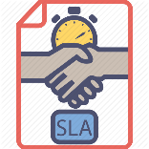
Apache Storm on HDInsight
Apache Storm offered as a managed service on Azure HDInsight
Scalable – Can analyse millions of events per second
One of 7 HDInsight Cluster Types
Dynamically Scale-up and scale-down
Integrates with Event Hub
SLA - 99.9% uptime
Develop with Visual Studio using Java or C#
Notes:
Provide Open source Apache Storm as a fully managed service
SLA of 99.9% up time
Build analytics pipeline on industry leading open source platform
Examples of some of the companies running on Apache Storm: https://storm.apache.org/documentation/Powered-By.html
Analyze millions of messages per second
HDInsight team runs a lab test that processes 1 million messages per second ingested from Eventhub
Built in Scale-up & Scale-down features
Customers can scale up and scale down a running cluster; with no impact to a running topology
Deep integration with Event hub
Program your Storm Topology in Java or C#
Enabled a first class support for writing topologies in C#
We have taken ease of programming to the next level by enabling mixed mode topologies, which means you can take an existing Spout written in Java but build the rest of the topology in C#.
The Storm service also comes with the Trident support.
Full integration with Visual Studio (click through experience captured in attached email)
Fully integrated Azure AUX experience (click through experience captured in attached email)
Write your data into HBase, SQL Azure, DocumentDB

Slide 73


Apache Storm
A highly scalable and reliable, open-source, distributed, stream processing framework
Streaming data analysis
Easy to program
A distributed real time processing platform
Fast
Clocked at 1M+ messages per second per node
Scalable
Thousands of workers per cluster
Fault Tolerant
Failure is expected, and embraced
Reliable
Guaranteed message delivery Exactly-once semantics

Slide 74
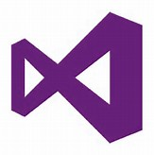
Visual Studio tooling
You can develop and deploy a Storm application without leaving Visual Studio
Create Storm projects from available template
Submit a topology with C# bolts/spouts
Submit Topologies containing Java spouts/bolts
Monitor Topologies within VS
Troubleshoot Topologies

Slide 75
Choosing Apache Storm ON HDInsight
When Apache Storm on HDInsight can be a good option
When You Want .. | Description
An open-source solution | Apache Storm is open-source, licensed under Apache License 2.0
A hybrid, multi-cloud solution with choice of deployment models | Apache Storm is available as a managed service on Azure, as an IaaS solution on Azure VMs, on-premises and as an IaaS solution on other public clouds.
A highly scalable solution | Storm architecture uses parallelism across clusters to scale. Powered by Apache Storm list some of the companies using Storm at large scale. Apache Storm processes many billions of messages per day for some of the customers.
Integration with Apache Kafka | “Apache Kafka + Apache Storm” is a popular combination. There is an Kafka Spout that makes it easy to consume Kafka data in Apache Storm.
Extensibility | Apache Storm has no restrictions on the code that runs in Spouts and Bolts. So, it is easily extensible.
Windowing Support | While, Apache Storm itself has no support for windowing, the higher-level framework Apache Trident does.
Integration with Visual Studio | Apache Storm on HDInsight integrates with Visual Studio so that you can develop and deploy a Storm application without leaving Visual Studio.

Slide 76
Data Processing
DATA PROCESSING
AZURE DATABRICKS
HDINSIGHT
AZURE DATA
FACTORY + IR/SSIS
Azure Databricks
Azure HDInsight
Azure Data Factory

Slide 77
Data preparation, transformation, processing requirements
Requirement | Comment
Scalability | The amount of data that needs to be processed at once can vary widely on any given day, or can grow over time. The batch data processing technology should scale to meet your needs with the level of granularity and within an acceptable time range for your solution.
Choice of language | The batch data processing technology should provide a choice of languages with which to create batch operations, including Python, Java, Scala, HiveQL, R, or U-SQL.
Integration choices | The batch data processing technology should allow you to choose a cloud-based data source from which to query, such as Azure Storage or Azure Data Lake Store. Some options allow additional integration options by also allowing you to query external relational data stores, such as SQL Data Warehouse.
Notes:
When evaluating technologies to use for data preparation, transformation and processing, several requirements should be considered.
Scalability of the technology should accommodate the amount of data that needs to be processed now, as well as in the future. Will the technology grow with your needs (and within your budget)?
How you configure and develop – what are your skills? Consider the languages and frameworks the technology should support. Python? SQL? Scala? R? And more.
Consider integrations of the technology, both “out of box” as well as third-party, open source, and ability to build custom integration components.

Slide 78
Data Prep and Transformation Offerings (1/3)
A side-by-side comparison of general capabilities and features
 | Azure Data Lake Analytics | HDInsight with Spark | HDInsight with Hive | HDInsight with Hive LLAP | SQL Data Warehouse | Azure Databricks
Is a managed service | Yes | Yes | Yes | Yes | Yes | Yes
Auto-scaling | No | No | No | No | No | Yes
Supports pausing compute | No | No | No | No | Yes | Yes
Programmability | U-SQL | Python, Scala, Java, R, SQL | HiveQL | HiveQL | T-SQL | Python, Scala, Java, SQL, R
Programming paradigm | Mixture of declarative and imperative | Mixture of declarative and imperative | Declarative | Declarative | Declarative | Mixture of declarative and imperative
Pricing model | Per job (by job run per hour times analytics unit used) | By cluster hour | By cluster hour | By cluster hour | By cluster hour | By cluster hour
Notes:
Now let’s look at several data preparation and transformation offerings in Azure. All of these are PaaS options.
Azure Data Lake Analytics (ADLA) is a job-based technology that uses the U-SQL language, which combines features from C# and T-SQL. It works with Azure Data Lake Store (ADLS v1), which we already discussed.
HDInsight, the managed Hadoop service on Azure, offers multiple data transformation options including Spark, Hive, and Hive LLAP. Note that HDInsight is based on Hortonworks, so Impala (available on Cloudera) is not available as part of HDInsight, but is available as an IaaS option.
Azure SQL Data Warehouse, which we already saw for data storage, is the managed MPP relational data warehouse offering on Azure.
Azure Databricks is the only first-party offering of Databricks on any of the clouds. Databricks is a managed Spark offering with additional capabilities such as autoscaling, the ability to pause compute, and more.
Databricks is growing very rapidly due to its wide programmability, autoscale and pause capabilities, and streaming and machine learning capabilities, in addition to Databricks-specific APIs and utilities.
You will use Databricks during the labs.

Slide 79
Data Prep and Transformation Offerings (2/3)
A side-by-side comparison of integration capabilities
 | Azure Data Lake Analytics | HDInsight with Spark | HDInsight with Hive | HDInsight with Hive LLAP | SQL Data Warehouse | Azure Databricks
Access Azure Data Lake Store | Yes | Yes | Yes | Yes | Yes | Yes
Query Azure Storage | Yes | Yes | Yes | Yes | Yes | Yes
Query external relational stores (like Azure SQL Database, SQL Server in virtual machine, or Azure SQL Data Warehouse) | Yes | Yes | Yes | No | Yes | Yes
Notes:
This table summarizes integration capabilities of these offerings. Remember that Azure Data Lake Store (ADLS) has the WebHDFS layer, which is how all these services are able to integrate with it. Similarly, most of these services have extensive integration and query capabilities with external stores, like the various SQL services.

Slide 80
Data Prep and Transformation Offerings (3/3)
A side-by-side comparison of scalability capabilities
 | Azure Data Lake Analytics | HDInsight with Spark | HDInsight with Hive | HDInsight with Hive LLAP | SQL Data Warehouse | Azure Databricks
Scale-out granularity | Per job | Per cluster | Per cluster | Per cluster | Scale out by compute units (DWU) | Per cluster
Supports fast scale out (less than 1 minute) | Yes | No | No | No | No | Yes
Supports in-memory caching of data | No | Yes | No | Yes | Yes | Yes
Notes:
This table summarizes various scalability capabilities including scale-out granularity and speed.

Slide 81
Azure Data Factory
Include data transformation activities in orchestration pipelines
HDInsight Compute Environments
Spark
Hive
Pig
Map/Reduce
Machine Learning Activities
Stored Procedures
Azure SQL DB
Azure SQL Data Warehouse
SQL Server
Custom Code on Azure Batch
Notebooks on Azure Databricks
Run SQL Server Integration Services (SSIS) packages on the ADF Integrated Runtime
Notes:
Azure Data Factory is not only a great data ingestion and movement solution, but also has the capability to orchestrate data transformation in various services.
ADF pipelines can include data transformation activities, including calling out to various HDInsight environments like Spark, Hive, and Pig, calling Stored Procedures in various SQL services, executing custom code in Azure Batch, and running Databricks notebooks on Azure Databricks clusters.
And for customers who have invested in building SQL Server Integration Services (SSIS) packages for enterprise ETL, ADF can also host and run SSIS packages in the cloud or on-premise as part of ADF pipelines.

Slide 82
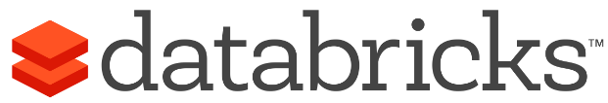
Azure Databricks
Azure Databricks is a first party service on Azure.
Unlike with other clouds, it is not a Marketplace or 3rd party hosted service.
Azure Databricks is integrated seamlessly with Azure services:
Azure Portal: Service an be launched directly from Azure Portal
Azure Storage Services: Directly access data in Azure Blob Storage and Azure Data Lake Store
Azure Active Directory: For user authentication, eliminating the need to maintain two separate sets of uses in Databricks and Azure.
Azure SQL DW and Azure Cosmos DB: Enables you to combine structured and unstructured data for analytics
Apache Kafka for HDInsight: Enables you to use Kafka as a streaming data source or sink
Azure Billing: You get a single bill from Azure
Azure Power BI: For rich data visualization
No need to create a separate account with Databricks.com.
Microsoft Azure
Notes:
Let’s specifically highlight Azure Databricks. Unlike with other clouds, on Azure, Databricks is a first-party service and is integrated seamlessly with a wide variety of other Azure services, including storage, data services, and more.

Slide 83
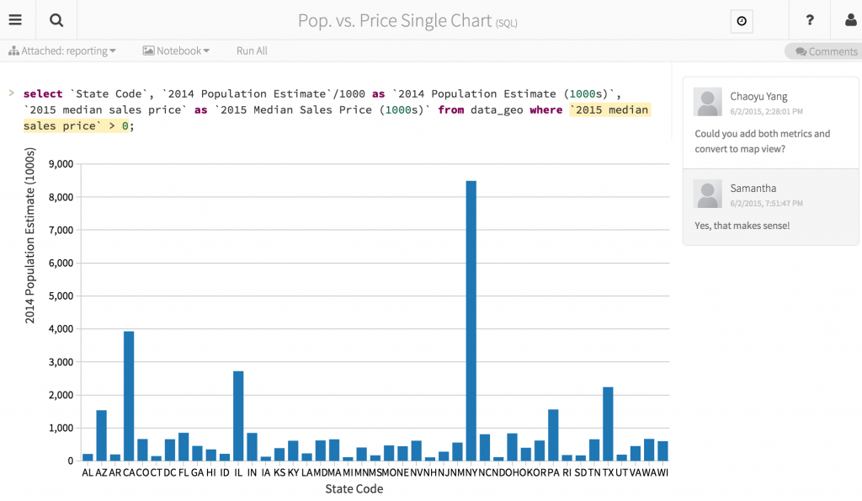
Azure Databricks Notebooks Overview
Notebooks are a popular way to develop, and run, Spark Applications
Notebooks are not only for authoring Spark applications but can be run/executed directly on clusters
Shift+Enter
click the at the top right of the cell in a notebook
Submit via Job
Notebooks support fine grained permissions—so they can be securely shared with colleagues for collaboration (see following slide for details on permissions and abilities)
Notebooks are well-suited for prototyping, rapid development, exploration, discovery and iterative development
Notebooks typically consist of code, data, visualization, comments and notes
Notes:
Databricks fully supports Jupyter notebooks to develop and run Spark applications, whether interactively or as jobs launched from Azure Data Factory pipelines.
Data developers familiar with Jupyter notebooks from other platforms will be immediately productive, and are also able to use additional Databricks capabilities like the Databricks utilities libraries. You will work in a Jupyter notebook on Databricks in the labs.

Slide 84
ML & AI
AZURE ML
COGNITIVE SERVICES
AZURE DATABRICKS
(Spark ML)
Azure Machine Learning Service
Azure Machine Learning Studio
Cognitive Services
Azure Databricks

Slide 85
Comprehensive deep learning,
machine learning as a service
Productive
Hybrid
Customizable services
VS, ML STUB, Tensor, Caffe
Tools
Bots, Cognitive, ML
Infrastructure and compute
CPU, GPU, FPGA
Intelligent
Azure
Trusted
Notes:
Azure offers a comprehensive set of services, tools, and infrastructure to build AI-powered experiences.
Offerings include machine learning and deep learning services, with support for leading open-source frameworks; AI services including the Azure Bot Service and a set of pre-trained Azure Cognitive Services; and compute infrastructure powered by the latest GPUs and FPGAs for the fastest inferencing and prediction.
Azure is an open AI platform, supporting not only leading frameworks but also platforms like Hadoop, Spark, and Databricks as well as tools like Jupyter notebooks. And of course, our own Visual Studio and Visual Studio Code have full AI tooling capabilities.

Slide 86
Machine Learning & AI Portfolio When to use what?
Microsoft ML & AI products
Build your own or consume pre-trained models?
Build your own
Consume
Spark ML, SparkR, SparklyR
Cognitive services, bots
Azure Machine Learning
Which experience do you want?
Code first
Visual tooling
Notebooks
Jobs
(On-prem) ML Server
Deployment target
(cloud)
AML (Preview)
(cloud)
AML Studio
Azure Databricks
What engine(s) do you want to use?
SQL Server
Hadoop
Azure ML Service
DSVM
Spark
Spark
On-prem Hadoop
SQL Server
Notes:
Azure offers many ML and AI technologies to help us model our data and gain insight from it. A decision tree is very helpful to start narrowing the choices.
A number of factors should be considered, including:
Are pre-trained models “good enough”? Azure offers a couple of dozen Cognitive Services, which are general, pre-trained models operationalized as APIs that developers can integrate. You will work with a Cognitive Service in the labs.
Who will be building and maintaining ML models? Code-first data scientists who prefer a notebook or command line? Or others who prefer graphical tools? What skills are available for languages and frameworks?
Where will the models need to run? More and more offerings on Azure are available to run outside of the cloud, including in Docker containers. SQL Server, ML Server, and Data Science VMs are other ML environments.

Slide 87
ML Modeling Requirements
Requirement | Comment
Scale for Training | The ML service should be able to train models on very large amounts of data (TBs or PBs) within specified time intervals. Ideally the ML service can train models in parallel on distributed framework running on a cluster.
Choice of Language | The ML service should provide a choice of languages with which to author training scripts and programs, including Python and R.
Choice of Algorithms | The ML service should provide a choice of algorithms across multiple categories (Regression, Classification, Clustering, Collaborative Filtering, etc.) so that the most accurate and efficient models can be developed.
Capture Training History | The ML service should enable the evaluation of model performance over time. This should enable spotting regressions in model performance, and support returning to a previous state that yielded better performance.
Enable Collaboration & Review | The training approach should be fully documented, ideally capturing prose descriptions along with code. The ML service should enable peers to easily collaborate in training, as well as share the documented training artifacts with stakeholders.
Graphical Tools | In addition to programmatic APIs, graphical tools should be available to author the training process as a graph—to help business analysts visualize the flow and to improve analyst’s productivity.
Support for Deep Learning | Deep Learning Frameworks—and GPU clusters to run them—are becoming popular. The ML service should support popular Deep Learning framework such as Microsoft Cognitive Toolkit (CNTK), BigDL and TensorFlow
Notes:
Let’s look a little more closely at requirements for Machine Learning Modeling. Those include:
The ML service should be able to scale, so that training happens in the timeframe (and budget) you need.
It should support the languages and frameworks matching your skills.
It should enable collaboration, review, dev/ops, and ideally support programmatic APIs, command-line, and graphical tools.

Slide 88
ML Options on Azure
Azure Machine Learning Service
Python SDK, CLI, Portal UI; Jupyter notebooks, Visual Studio Code
Compute environments include containers, Kubernetes, IoT Edge devices, Azure Databricks, batch VMs, etc.
Broad library support: Scikit-learn, Tensorflow, Pytorch, CNTK, more
Automated ML: evaluate many models and settings to find the best model
Azure Databricks
Spark and notebooks experience; single engine for all processing
Broad library support: Tensorflow, CNTK, BigDL, more
Azure Machine Learning Studio
Graphical, browser-based tool; excellent for non-professional data scientists
Very easy training, evaluation, operationalization to REST API web service
ML Server
On SQL Server, on premise, in cloud on HDInsight
Data Science Virtual Machine (DSVM)
Pre-configured VMs (Linux and Windows) with major tools installed
GPU configurations available
Notes:
Azure offers many Machine Learning options, as you saw on the decision tree. This is a quick overview of the major ones.
Azure Machine Learning Service is the service and toolset to train, deploy, automate, and manage ML models at cloud scale with broad tool, library, and compute environment choices.
Databricks, which we’ve already discussed, offers a single engine for batch, streaming, and machine learning processing with support for many ML and deep learning libraries and frameworks plus GPU cluster types.
Azure Machine Learning Studio is different from Azure ML Service. ML Studio is a graphical, browser-based ML tool that is very easy for people to use who are not professional data scientists. It offers very easy operationalization and deployment of trained models to web services that can be integrated into other Azure services like Stream Analytics (which you will use in the labs today), or integrated by developers like any other REST API.
Microsoft Machine Learning Server runs in-database on SQL Server, or standalone on premise, as well as on HDInsight clusters. It supports both R and Python.
Linux and Windows Data Science VMs are available both as productivity environments for data scientists and data professionals, as well as being one of the choices for ML model compute environments from Azure ML Service.
We are not diving into great detail on machine learning today, since in the labs you will use a different Azure AI capability, not custom machine learning.

Slide 89






Microsoft Cognitive Services Give your apps a human side
Vision
From faces to feelings, allow your apps to understand images and video
Speech
Hear and speak to your users by filtering noise, identifying speakers, and understanding intent
Language
Process text and learn how to recognize what users want
Knowledge
Map complex information and data in order to solve specific tasks
Search
Access billions of web pages, images, videos, and news with the power of Bing
Labs
An early look at emerging Cognitive Services technologies: discover, try, and give feedback on new technologies before general availability
Notes:
In addition to the Machine Learning options we just discussed, there is a set of pre-trained AI services – Cognitive Services – available on Azure. These services span many use cases and capabilities. All of them are exposed as REST APIs, which means they are as easy to integrate with your platforms and applications as other REST APIs.
Cognitive Services are available across five categories: Vision, Speech, Language, Knowledge, and Search. There are also pre-release services available for testing in the Labs category.

Slide 90
Microsoft Cognitive Services
Vision
Speech
Language
Knowledge
Search
Video Indexer
Speaker Recognition
Text Analytics
QnA Maker
Bing Entity Search
Computer Vision
Bing Speech
Bing Spell Check
Custom Decision
Bing Autosuggest
Face
Custom Speech
Translator Text
Bing Search
Emotion
Translator Speech
Language Understanding (LUIS)
Bing Statistics add-in
Content Moderator
Unified Speech
Content Moderator
Bing Visual Search
Custom Vision
Bing Custom Search
Notes:
This is a detailed list of the services available in each category.
You will be working with the Text Analytics cognitive service (in the Language category) in the labs.

Slide 91



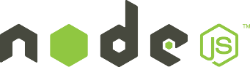




Why Microsoft Cognitive Services?
Easy
Flexible
Tested
Roll your own with REST APIs
Simple to add: just a few lines of code required
Integrate into the language and platform of your choice
Breadth of offerings helps you find the right service for your need
Bring your own data for your custom experience
Built by experts in their field from Microsoft Research, Bing, and Azure Machine Learning
Quality documentation, sample code, and community support
Get a key,
Build
Notes:
Why choose these APIs ? They work, and it’s easy.
Easy: The APIs are easy to implement because they are REST APIs, which many developers are very familiar with integrating. You can get started with all of them simply by going to one place, www.microsoft.com/cognitive.
Flexible: As you saw in the previous slide, there are many services for many needs; and importantly, they all work on whatever language, framework, or platform developers choose because, again, the services are exposed as REST APIs.
Tested: The powerful AI algorithms that drive these services were developed by experts from Microsoft’s Research organization, Bing, and Azure machine learning, and these capabilities are used across many Microsoft first party products such as Cortana, Bing and Skype.

Slide 92
Serving Storage
SERVING STORAGE
AZURE SQL
DATA WAREHOUSE
AZURE ANALYSIS
SERVICES
AZURE SQL DB
COSMOS DB
Azure SQL Data Warehouse
Azure Analysis Services
Azure SQL Database
Cosmos DB

Slide 93
Data serving
A side-by-side comparison of general capabilities and features
 | SQL Database | SQL Data Warehouse | Analysis Services
Is a managed service | Yes | Yes | Yes
Primary database model | Relational (columnar format when using columnstore indexes) | Relational tables with columnar storage | Tabular semantic models
SQL language support | Yes | Yes | No
Optimized for speed serving layer | Yes, using memory-optimized tables and hash or nonclustered indexes | No | No
Notes:
Now let’s discuss some PaaS serving technologies for stored structured data. This layer serves processed data to analytic clients, reporting tools, dashboards, and other consumers.
Azure SQL Database is a managed SMP relational database. There is both Single Instance as well as the new, full-featured Managed Instance (in preview). There are also managed relational database services for MySQL, Postgres, and MariaDB, so Azure offers a rich set of relational database choices for data marts in a serving layer.
Azure SQL Data Warehouse is a managed MPP relational data warehouse. It’s optimized for analytic queries over very large volumes of data, by contrast to the SMP data services that are more optimized for transactional processing.
Azure Analysis Services is a managed service based on the SQL Server Analysis Services (engine). It provides tabular semantic models for fast ad-hoc analysis over large amounts of data.
All these services integrate with other Azure services such as Azure Active Directory for security, Azure Data Factory to load data into the model, and more. You can work with these services with tooling you know, including SQL Server Management Studio, Azure Data Studio, SQL Server Data Tools, and more.

Slide 94
Data serving
A side-by-side comparison of scalability capabilities
 | SQL Database | SQL Data Warehouse | Analysis Services
Redundant regional servers for high availability | Yes | Yes | No
Supports query scale out | No | Yes | Yes
Dynamic scalability (scale up) | Yes | Yes | Yes
Supports in-memory caching of data | Yes | Yes | Yes
Notes:
Here, we’re comparing scalability capabilities for these serving technologies.
It’s important to note that these technologies can be combined in a modern data estate. For example, it’s a very common pattern to see an MPP data warehouse perform various data processing over large amounts of data, then to load the processed data into data marts in relational databases and cubes in Analysis Services, with those marts and cubes serving the consumption layer.

Slide 95

Cosmos DB ROLES
As a long-term store for Streaming Data
As a sink for processed streaming data
As an ingestion engine for Streaming Data
As a mutable source of Streaming Data for Stream Analytic frameworks (Spark Streaming, Storm, Stream Analytics)
As a event processing engine (e.g. using Azure Functions)
Process & Analyze Events
Ingest and Store
Query & Update
CHANGE FEED
Notes:
Now let’s take a look at Cosmos DB, which can fulfill multiple roles in a data architecture.
It can function as a cold store; it can also function as a hot store, since it provides extremely low latency.
It can function as part of a stream processing pipeline, since it can ingest data, operate on it, and then emit a stream of new or updated records in its Change Feed, which in turn can be ingested by serverless Azure Functions or by other stream analytics technologies like the ones we’ve already looked at.
Cosmos DB is a multi-model, multi-geo database and is the only database to offer not one, but four separate financially backed SLAs. By multi-model, we mean that it’s more than “just” a NoSQL database; it has always handled document data (it was originally named “DocumentDB” several years ago...) and also handles table key-value and graph data, as well as offering protocol compatibility for Cassandra and MongoDB.
It scales elastically, and offers fine-grained consistency choices, SDKs on the major platforms, automatic indexing, easy partition management, and much more. As with everything else we’re discussing today, Cosmos DB is a PaaS managed service, so there’s no patching and rebooting to worry about.

Slide 96
Cosmos DB CHANGE FEED
Change Feed can trigger actions when data changes in Cosmos DB
Listens to changes in Cosmos DB and output sorted list of documents that were changed.
Changes are persisted, can be processed asynchronously and incrementally.
Changes can be read by:
Using Azure Functions
Using the Azure Cosmos DB SDK
Using the Azure Cosmos DB Change Feed Processor library
Notes:
Note:
Change feed support is provided for all data models and containers in Azure Cosmos DB. However, the change feed is read using the SQL client and serializes items into JSON format. Because of the JSON formatting, MongoDB clients will experience a mismatch between BSON formatted documents and the JSON formatted change feed.
The change feed is available for each partition key range within the document collection, and thus can be distributed across one or more consumers for parallel processing.
Additional details:+
Change feed is enabled by default for all accounts.
You can use your provisioned throughput in your write region or any read region to read from the change feed, just like any other Azure Cosmos DB operation.
The change feed includes inserts and update operations made to documents within the collection. You can capture deletes by setting a "soft-delete" flag within your documents in place of deletes. Alternatively, you can set a finite expiration period for your documents via the TTL capability, for example, 24 hours and use the value of that property to capture deletes. With this solution, you have to process changes within a shorter time interval than the TTL expiration period.
Each change to a document appears exactly once in the change feed, and clients manage their checkpointing logic. The change feed processor library provides automatic checkpointing and "at least once" semantics.
Only the most recent change for a given document is included in the change log. Intermediate changes may not be available.
The change feed is sorted by order of modification within each partition key value. There is no guaranteed order across partition-key values.
Changes can be synchronized from any point-in-time, that is, there is no fixed data retention period for which changes are available.
Changes are available in chunks of partition key ranges. This capability allows changes from large collections to be processed in parallel by multiple consumers/servers.
Applications can request multiple change feeds simultaneously on the same collection.

Slide 97
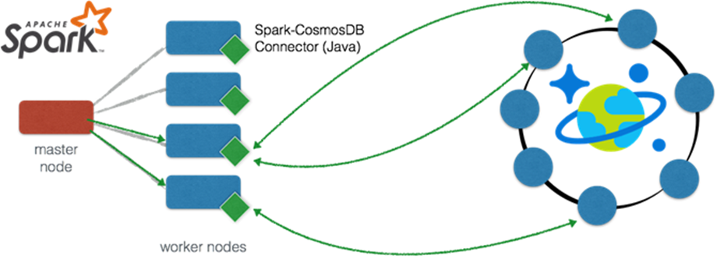
Cosmos DB-Azure Spark integration
The Spark connector enables real-time analytics over globally distributed data in Azure Cosmos DB
Spark connector for Azure Cosmos DB: Enables Apache Spark to interact with all Azure Cosmos DB data models: Documents, Tables, and Graphs.
efficiently exploits the native Azure Cosmos DB managed indexes and enables updateable columns when performing analytics.
utilizes push-down predicate filtering against fast-changing globally-distributed data
Notes:
Some use-cases for Azure Cosmos DB + Spark include:
Streaming Extract, Transformation, and Loading of data (ETL)
Data enrichment
Trigger event detection
Complex session analysis and personalization
Visual data exploration and interactive analysis
Notebook experience for data exploration, information sharing, and collaboration
The connector uses the Azure DocumentDB Java SDK and moves data directly between Spark worker nodes and Cosmos DB data nodes

Slide 98
Lab Scenario (fictional!)
Two taxi companies (Yellow and Green)
Years of historical trip data as CSV; always received in batch, long after trip
No connection to customers, no way to address negative experiences
Decision to do Proof of Concept (PoC):
Deploy connected devices to taxis (use a device stream simulator in the PoC)
Stream trip data – no more CSVs/batches
Get customer feedback with payment
See negative customer experiences right away to enable quick response
Enable unified analytics on historical and new streaming data
Minimize operational, admin, infrastructure overhead – cloud and PaaS
Your mission: deploy a functional all-PaaS architecture for this scenario
Notes:
The scenario for our labs today is as follows.
You are a technical architect. You are working with two taxi companies, Yellow and Green. These taxi companies have been in business for several years, and have extensive historical taxi trip data which they receive in periodic batches of CSV files, well after the trips. Because their data changed formats over the years, they have difficulty doing historical analysis.
The companies have decided to unify their trip data format; to deploy connected devices to all their taxis so that trip information is streamed wirelessly into their environment, and so they can get rid of batches of CSV files; and to request customer comments at payment time. Additionally, the companies would like to know right away when customers have bad taxi trips, so that customer support can reach out to the customers right away instead of risking bad public reviews and social media posts.
They need to keep all their historical data, and they need traditional business intelligence reports to work on both their historical data as well as the new streaming data from the taxi devices.
The taxi companies operate very lean due to competitive pressure. The new data estate has to require minimum maintenance and administrative overhead. Because of this, Platform as a Service (PaaS) technologies are preferred wherever possible.
In today’s labs, you will build and run an architecture that accomplishes all these goals.

Slide 99
Lab Overview
You will build a simple, end-to-end data architecture with batch and streaming analysis paths and AI enrichment
You will work in Azure and Power BI
You will gain experience with several Azure technologies
Our goal: realistic to finish all the labs today
Labs are very detailed and step-by-step
Not open-ended “from scratch, figure it out” hack event (we do those too!)
After today: build on labs, experiment, try other technologies
Made a lab better? How about submitting a Pull Request?
Notes:
The labs today will result in you building a simple lambda architecture. If you don’t know that term, we’ll discuss it shortly.
You will work with several Azure technologies as well as Power BI today. Our goal is to have you finish all the labs today without requiring deep expertise or extensive open-ended research. That’s why the lab docs are very detailed, with lots of screenshots, and spell out the various tasks and steps for you.
We hope this approach is useful to you, and we encourage you to build on these labs. Experiment, try other technologies, and if you make a lab better for future attendees to this event, please consider submitting a Pull Request! (See the link for all the materials.)

Slide 100
Lab Architecture
Notes:
This is the architecture you will build today, broken out by lab. The lab documents cover all of this in detail, but let’s review the architecture and labs here at a high level before we get into the presentation.
Our session today, and the labs you will work on, are on a modern data architecture with “hot” and “cold” data paths and analysis capabilities. We will discuss that architecture pattern and the various technologies on Azure you can use to build these in a few minutes, but for now let’s focus on the various labs you will do.
Labs 1 and 2 are on the “cold” path, while labs 3 and 4 are on the “hot” path.
In lab 1, you’ll ingest and store a public data set into your Azure environment. That data set has some problems. You will do data engineering and ETL work in Azure Databricks to transform the raw source data into a data set suitable for further analysis, and emit that transformed data back to Azure storage.
In lab 2, you will use Azure Data Factory to ingest data from the transformed data set you built in lab 1 into a relational data mart, and then you will build traditional BI reports on top of that data mart. Today you will use Azure SQL Database for the data mart; in more elaborate architectures, you might have an MPP data warehouse here (such as Azure SQL Data Warehouse) plus an OLAP service (such as Azure Analysis Services) in addition to relational data marts. But for today, we are keeping it simple so that we have time for the later labs.
In lab 3, you will work on an inbound data stream. You’ll deploy a simulator app that generates a stream of events. You’ll deploy stream ingestion using Azure Event Hubs. And you’ll add stream enrichment; each message in the stream will be enriched by a serverless Azure Function, which will call an Azure AI service – the Text Analytics Cognitive Service – to perform text analytics and enrich each message with the result of that analysis. You’ll then forward the enriched message on to another stream ingestion endpoint.
In lab 4, you will perform simple stream analytics using Azure Stream Analytics to accomplish two tasks.
First, you will write all the stream data to cold path storage, where the existing historic data is stored. This is to accomplish the goal of analytics over all data – historic as well as new streaming.
Second, you will also send events meeting a certain qualifier on to a streaming dashboard, for rapid visualization of events needing a quick response. Specifically, you will send events where the customer sentiment is negative to a streaming dashboard, so that the taxi companies’ customer support can react right away.
Remember that if you do not finish all the labs today, you have access to all the lab docs at the main materials link shown earlier.

Slide 101
Lab Environment
If you use the Azure environment provided for today:
A Windows VM is provided – access via RDP
You do not HAVE to use the VM, but it can be useful for:
Lab 2: if you decide to use SQL Server Management Studio instead of the Azure portal SQL query explorer, it is pre-installed on the Lab VM
Lab 2: Power BI Desktop is pre-installed on the Lab VM
Lab 3: deploy the device simulator to the Lab VM, not your laptop
Remember: Azure lab environments will be deleted after 10 hours
Notes:
The labs today will result in you building a simple lambda architecture. If you don’t know that term, we’ll discuss it shortly.
You will work with several Azure technologies as well as Power BI today. Our goal is to have you finish all the labs today without requiring deep expertise or extensive open-ended research. That’s why the lab docs are very detailed, with lots of screenshots, and spell out the various tasks and steps for you.
We hope this approach is useful to you, and we encourage you to build on these labs. Experiment, try other technologies, and if you make a lab better for future attendees to this event, please consider submitting a Pull Request! (See the link for all the materials.)

Slide 102
Lab Tips
Work in an anonymous/private browser window
Or clear all browser history/cookies before you start
Careful copy/pasting long command lines out of lab docs – suggest using a text editor/scratchpad
Notes:
The labs today will result in you building a simple lambda architecture. If you don’t know that term, we’ll discuss it shortly.
You will work with several Azure technologies as well as Power BI today. Our goal is to have you finish all the labs today without requiring deep expertise or extensive open-ended research. That’s why the lab docs are very detailed, with lots of screenshots, and spell out the various tasks and steps for you.
We hope this approach is useful to you, and we encourage you to build on these labs. Experiment, try other technologies, and if you make a lab better for future attendees to this event, please consider submitting a Pull Request! (See the link for all the materials.)

Slide 103
Additional Resources – Blogs, Whitepapers, Cloud Workshops
https://docs.microsoft.com
https://www.microsoft.com/trustcenter
https://academy.microsoft.com
https://www.microsoft.com/learn
https://azure.microsoft.com/blog/implementation-patterns-for-big-data-and-data-warehouse-on-azure
https://azure.microsoft.com/blog/near-real-time-analytics-in-azure-sql-data-warehouse
https://github.com/Microsoft/MCW-Big-data-and-visualization

Slide 104
Take a break
Start working on Hands-On Labs
Work at your own pace – take breaks and eat as works for you
We’ll leave the slide with the resource and labs links up
Proctors are here to help
Have fun!
Next

